Slide 1
Realty one group RESULTS BUYER’s 5 step PATH TO HOMEOWNERSHIP!
VIP BUYER MEETING

Slide 2
5 STEPS TO YOUR NEW FRONT DOOR!
I WANT TO BUY A HOME, WHAT NOW?

Slide 3
Educating the consumer & defining expectations: keeping your personal information private is important until you dicide if you want to form agency with me as your realtor! Different forms of agency ~ - Buyer agency: I represent you, have your best interest at heart, be loyal to you, follow your lawful instruction, provide all material facts that could influence your decisions, use reasonable skill, knowledge, and diligence, and account for all monies I handle for you. - Dual Agency: myself OR my firm will represent BOTH parties fairly, honestly, and will disclose ALL material facts. - Seller Subagency: you have not chosen to form agency with me therefore, I am a subagent of the seller and while still being fair to you and disclosing any material facts, my fiduciary duties are to the seller. - Designated Agency: rather than dual agency (me or my firm representing both you and the seller), another agent will be appointed to assist you as the buyer should you choose to offer on a home that is one of my own listings so you can be represented to the fullest. Prior to submitting an offer on a property, you need to have decided on and signed a buyers agency agreement with the real estate professional of your choice per the NC Real Estate Commission!

Slide 4
WHY DO I NEED A BUYER AGENT?
- Buying a home is a MULTI STEP PROCESS
- You need help identifying a property that conforms to the type of loan you are getting. Lenders now qualify buyers AND the property
- You need help identifying lenders that have good rates and terms based on YOUR needs and current savings
- You need help determining what a good and reasonable offer would be on the house YOU love. You want the best price but don’t want to insult the seller and compromise your negotiations.
You need INFORMATION on the area, schools, safety, resale
- You need help getting reputable inspectors opinions to ensure a sound and safe investment—just because it looks good on the surface does NOT mean it is!
- You need help negotiating necessary repairs and verifying they have been handled in a quality manner BEFORE you move in
- You need help securing a reputable real estate closing attorney to ensure you are not assuming someone elses judgements or liens and that you have an insurable title
- An average home buying transaction involves almost 30 different people to bring it all together, you need help coordinating and communicating with them! You need someone looking out for YOU
- You need help getting utilities transferred, homeowners insurance in place, address changes, moving discounts & coordination of all pieces, so that you show up at the closing knowing what to expect
You need help verifying that all dates are met in a timely manner so that you don’t forfeit your deposits!

Slide 5
Let’s Sign our Buyer Agency Agreement!
REMEMBER, these are FREE services to you the BUYER! The SELLER PAYS COMMISSION *in most cases*
Check your ONE APP several times a day for new listings and price reductions!
Check your emails and text messages for new listing alerts from me! What contact method do you prefer? Call, text, email?
If you see a for sale by owner please contact me ASAP so I can set up the appointments and guide you through the process!
If you see a listing from another company and want more information or to view call me or request to tour it on your ONE APP.
If you want to go to an Open House please give my card to the agent on duty so they can let me know you attended and let me know any pertinent information.
Remember this is a TEAM EFFORT and I am here to navigate you through the process and answer ALL questions!!
My goal is to get you the BEST pricing and terms available FOR YOU, my client, so that we can meet your financial goals!

Slide 6
LET’S GET PREQUALIFIED…
Chloe Joines
Integrity Mortgage Group
336-964-4983
CJoines@integritymtgs.com
Sam Collier
McLean Mortgage Corporation
336-501-2101
Scollier@mcleanmortgage.com
We need this ASAP before we include or exclude certain properties. This will also determine what price point we should be looking in!
A Pre-qual is also important because it allows you to be ready to submit an offer as soon as you find the right home!
Checking with a couple different lenders to compare rates and services is never a bad idea and your credit will not be effected by multiple inquiries if they're performed within 30 days of each other.

Slide 7
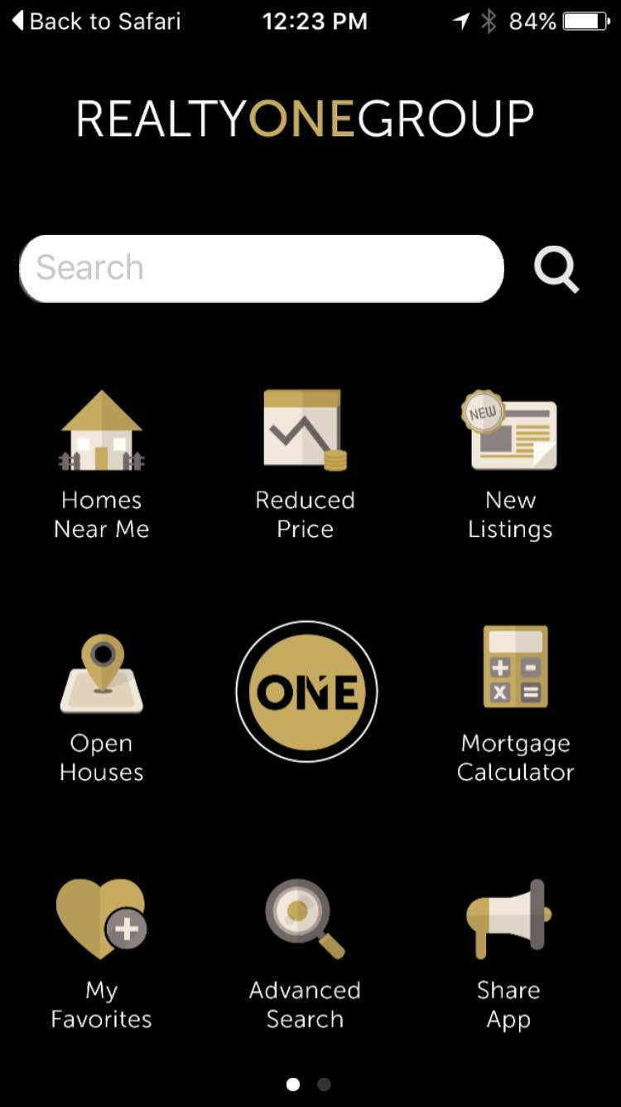
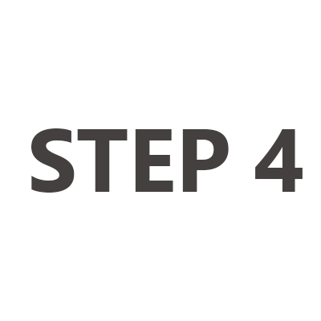
Next: Download my one app
LET’S DOWNLOAD MY ONE APP
Let me show you how it works…

Slide 8
FINALIZE
-WHO are your decision makers?
-WHAT are your top 3 NON negotiables (in a home)?
-WHICH days and times are you available to look?
-WHEN: Are you ready to move within 90 days?
-WHAT IS YOUR WHY? What is your CORE motivation for buying a home?
-Let’s set our first appointment!
TAKE MY CARD WITH YOU!

