Slide 2
YOUR NAME HERE
"If you help enough people reach their goals, you will succeed in life, period."
NC Broker
Say a little about yourself
Add
You
Picture
Here and
A quote (if wanted)
cell
email
Website:
Add the areas of coverage here

Slide 3
Client
Testimonials
Add
Your
Testimonial
here

Slide 5
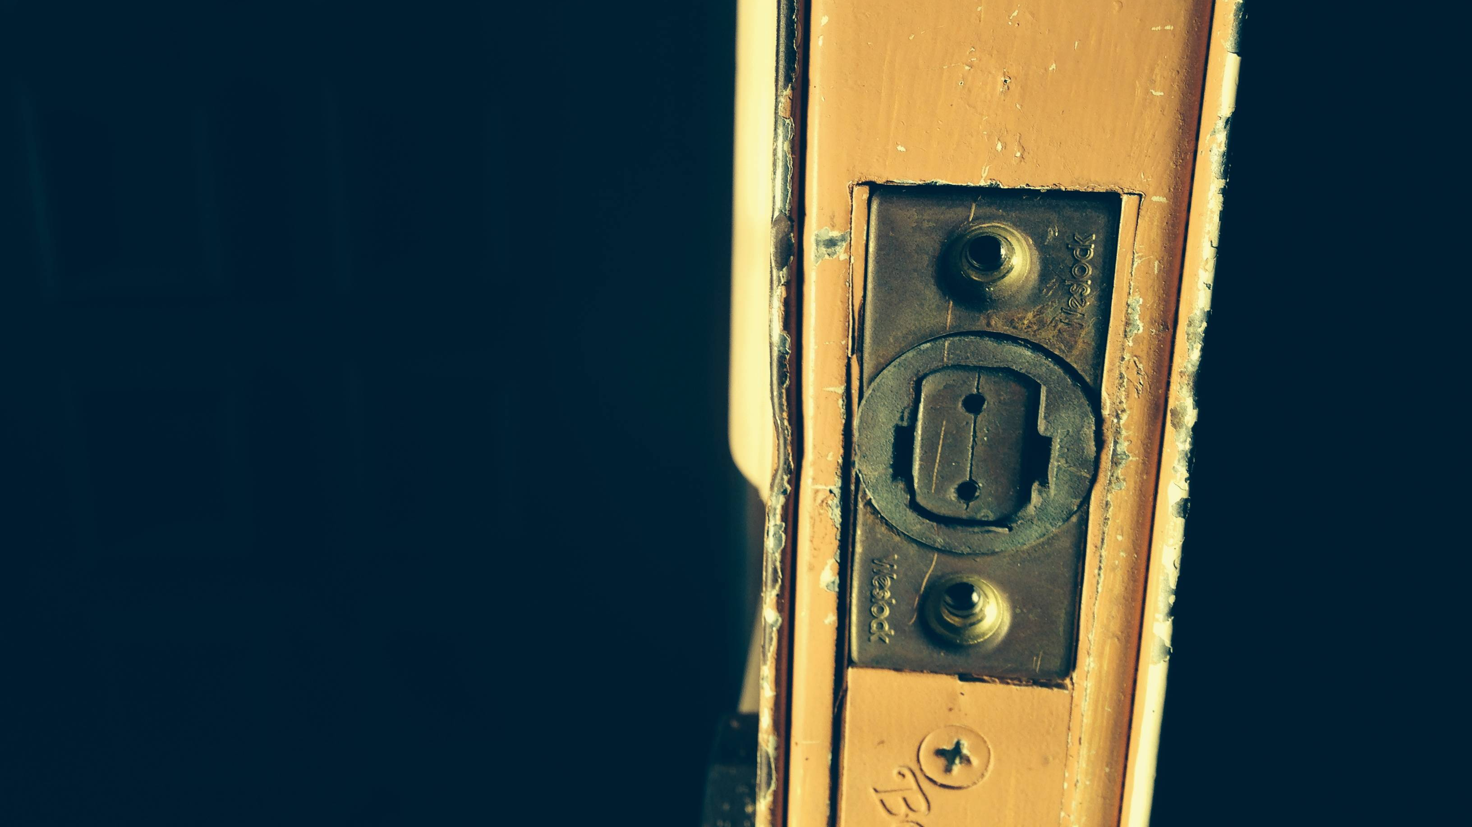
Opening Doors
Home
Dream
Life at a Time
Changing Lives
The Realty ONE Group
Golden Buyer Experience
WHAT YOU CAN EXPECT

Slide 6
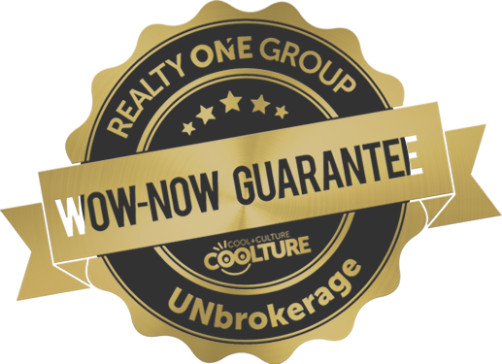
A lot of people think that once we find the home and have successfully negotiated an acceptable offer, that our work is finished. Actually, once you and the Seller are in agreement, that is when the greatest amount of work begins! Most of it will be done behind the scenes and you won’t even be aware of it. However, occasionally we come across something that might cause a delay, such as repairs or a title issue that wasn’t of public record to begin with. If something like that comes up, our transaction coordinator and I will communicate with you right away and help you through it. Our job is to make the transaction as smooth and stress-free as possible for you!
Taking care of you….
Before
During
and after your purchase
1. Broker/Buyer consultation to determine needs/wants
2. Lender Introduction, if needed;
3. Best loan product selected;
4. Lender Pre-Approval letter obtained;
5. Representation Agreements Signed;
6. Home Search App installed one phone;
7. MLS Matrix search/auto email created;
8. Let the search begin – pick your favorites, make your list;
9. Showing appointments made;
10. Property showings;
11. Evaluation of properties;
12. Revise criteria for search, if necessary;
13. Selection of property; and
14. Offer made and negotiated
15. UNDER CONTRACT!
1. Buyer submits due diligence and earnest money deposit to Seller/Agent/Closing Attorney.
2. Loan application signed;
3. Home/Pest/Radon/Inspections;
4. Repairs Negotiated;
5. Survey, if necessary;
6. Lender documentation requirements satisfied;
7. Appraisal performed;
8. Price adjustment negotiations with Seller, if necessary;
9. Home Owners Insurance obtained
10. Concierge Moving Service consultation for utility hook-ups;
11. Title issues resolved;
12. “Clear to Close” issued by Lender;
13. Final walk-thru
14. CLOSING DAY.
1. Optional House Warming Party;
2. Monthly home maintenance tips by email;
3. App for Owners Manuals and Warranty information for home appliances; and
4. Quarterly Coupons of value.

Slide 7
You see a For Sale Yard Sign or Open House sign?
CALL/TEXT ME A yard sign or open house can let you know a home is available, but I can help you know if it’s worthwhile.
See a home advertised online, social media, in newspapers, buyer’s guides, or a FSBO?
CALL/TEXT ME
You can ask me about ANY properties that are advertised, no matter who the broker is.
What if…
Our office offers area-wide multiple listing information that shows thousands of broker-listed homes for sale, regardless of the seller’s agent, so CALL/TEXT ME
When visiting an open house or new construction home on your own, give the salesperson my card and tell them I am your agent.

Slide 8
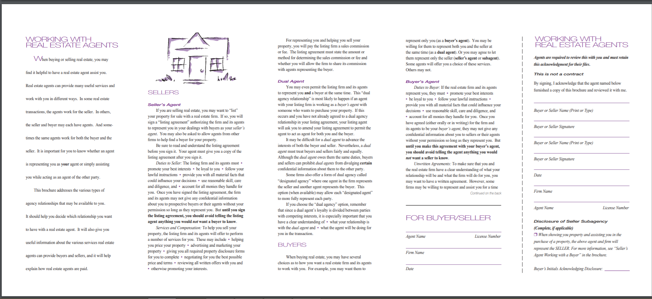

Slide 9
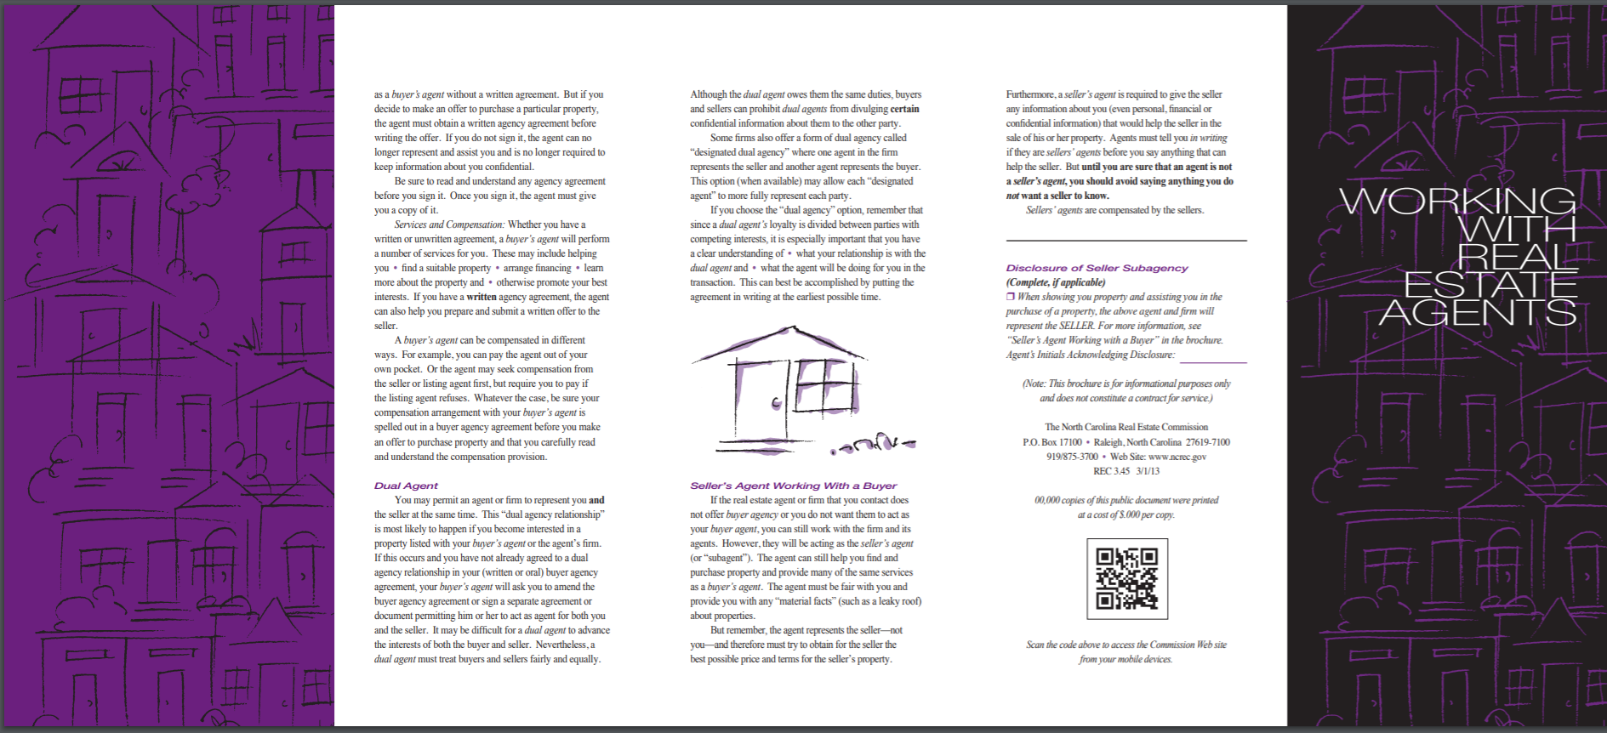

Slide 11
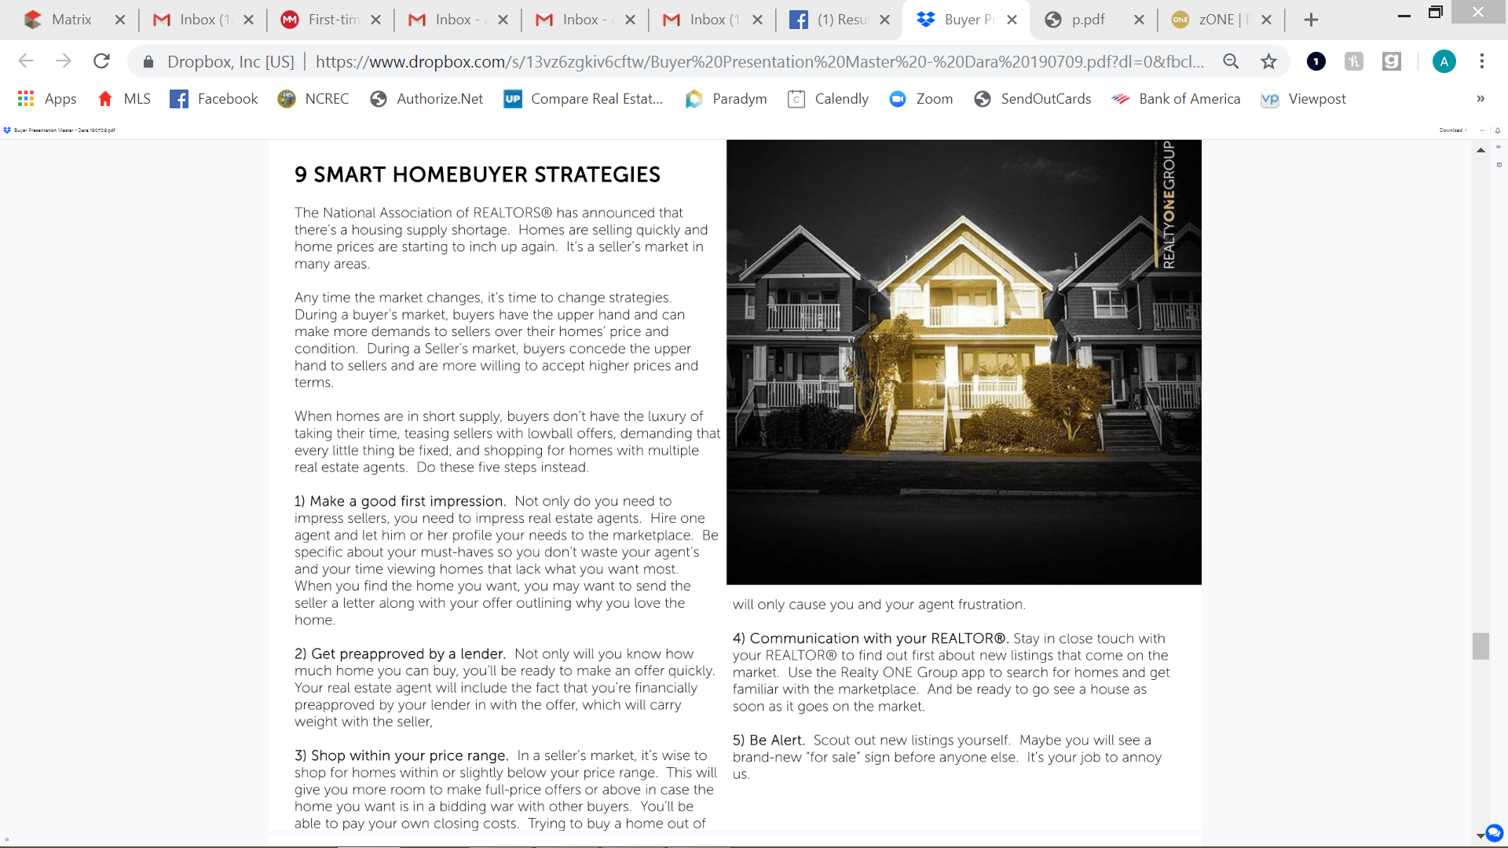

Slide 16
First-time homebuyer tips for you
By AJ Ramirez
Movement Mortgage
Blog 6/10/2019

Slide 17
If you’re a first-time homebuyer feeling completely lost with just starting your mortgage process, welcome to your first-time homebuying 101.
Am I even considered a first time homebuyer?
This might initially sound like a “duh” question with a “duh” answer to you. But you’d be surprised how many scenarios can actually consider you a first-time homebuyer. At face value, you would think it would mean this is the first time you’ve ever purchased a home. However, in the mortgage world, being a first-time homebuyer includes:
-Three years of non-homeownership
-Your current home isn’t really “yours”
-You’ve fulfilled the waiting period after short-sale or foreclosure
-And of course, you do also count if you’ve never purchased a home at all.
Exclusive benefits for first time-homebuyers
You may not have been aware, but there are specific first-time homebuyer programs that come with their own set of benefits. Some of these programs even come with options to get a home loan with zero down.
A first-time homebuyer program is a home loan scenario that has been created specifically to assist a first-time homebuyer in becoming a homeowner. Whew – we’ve got that out of that way. Now, what does that mean?
These loan programs often have looser requirements, like a lower down payment requirement. Most people believe that you are required to have 20% in order to qualify for a mortgage. This is just not true. Depending on the type of home you’re looking to purchase, or your qualifiers, you may be eligible for options that only require as little as 3% down. But wait. There’s more: Some options will cover 100% of home loan financing. And in case that wasn’t good enough news for you, there are a plethora of down payment assistance programs out there too. Many specific to aiding first-time homebuyers. Quite an advantage, huh?

Slide 18
What’s an interest rate?
You’ve probably heard about the term “interest rate” and that it’s something you’ll need to pay attention to. You may be familiar with a generic definition at this point. But to break it down, an interest rate is the annual cost to borrow money from your selected lender. With that being said, you may now also be wondering: What is the average first-time homebuyer interest rate that I can expect? This will always be dependent on several factors, but your credit score weighs heavily into it. When preparing to purchase your first home, you may want to consider carving out time to work on credit repair. Just to be sure you’re in tip-top shape for a pre-approval.
Good to know – what do I do now?
Speak with a loan officer first to find out what you qualify for upfront. While you may hear to start off with a realtor, it will be more helpful to know your finances first. This way, you know your budget for what kind of home you can actually afford.
From there, speak with a real estate agent and comb through what you want out of a home. However, make sure that you thoroughly go over this a few times. You may get excited about the thought of buying your first home. But stay realistic with how many of those features fit into your budget. When you have your “have-tos” nailed down, your realtor will be able to start showing you homes that align with your wants/needs and your finances.
Following our tip, you’ll already know what you’re pre-approved for upfront (if qualified). With your pre-approval in hand, you’ll be able to put in an offer to that soon-to-be new home of yours, and then follow the rest of the loan process with your loan officer.

Slide 19
Don’t get too excited there, champ
It’s a very exciting time. The freedom of picking out wall colors. New furniture. Your own door and drawer knobs you picked up Hobby Lobby. Gee, even the thought of installing shelves sounds great, doesn’t it? (When did the thought of shelves get exciting, right?) But beware to not fall into common mistakes first time home buyers make.
Make sure you talk with your loan officer to appropriately estimate all costs. There are several fees involved in buying a home, not just the initial down payment or the monthly mortgage costs.
One of the most lethal (to your mortgage loan process, at least) mistakes you can make is huge purchases before you’re actually done buying your home. If you start getting overzealous with the thought of items to fill up your home, you might not be able to actually purchase that home to begin with. There are certain checkpoints up until closing time where your debt load or debt-to-income ratio will be double or triple checked before sealing the deal. If you’ve exhausted funds, or added more debt, before the completion of your mortgage financing, it could end up in a denial at the last minute.
The home loan process requires several checks in order to affirm to the lender that you are truly responsible enough to lend that large lump of money to. So don’t jeopardize yourself by getting too antsy with the money burning a hole in your pocket.
One of the biggest takeaways you should get from our first-time homebuyer tips is that you are not alone. Nor do you have to go through it alone. You have professionals at your disposal that do this every day and are ready to serve you.

Slide 20
Financing your home….
Applying for a mortgage
The lender may request copies of:
Current pay stubs
Bank statements
Credit card statements
Investment/brokerage firm statements
Loan statements
Tax returns, usually for two years
Then…
Loan application is completed and submitted to lender
Lender orders appraisal, credit report, verification of your employment and assets
Lender provides a good faith estimate of closing and related costs, plus initial Truth In Lending disclosures
Lender evaluates application & support documents, approves loan and issues letter of commitment
Fixed Rate vs. Adjustable Rate
Fixed Rate Mortgages
Have the same interest rate for the entire term of the loan
Payments are stable and predictable
Higher interest rates than others
Adjustable Rate Mortgages (ARMs)
Have interest rates linked to a financial index that changes periodically over the life of the loan
Initial payments may be lower, making the ARM more affordable
How much can you afford?
Prequalification
Establishes how much you can afford to borrow
Is not an assurance of mortgage approval
Preapproval
Is a firm decision on a home loan
Makes you a “cash buyer” in seller’s eyes
Gives you increased bargaining power

Slide 21
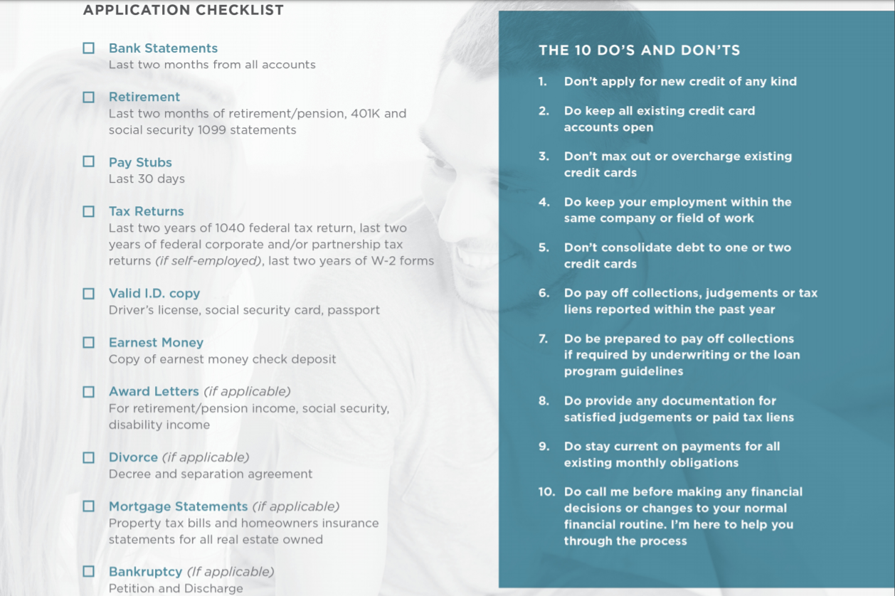

Slide 22
YOU

