Slide 1
Interviewing a buyer
RESULTS
7/29 @ 1PM w Teresa

Slide 2
WHAT WE WILL COVER TODAY…
1) What is an interview and why do we do it with buyers? Avoiding Short-Sightedness!
2) Interviewing a buyer before meeting to view a home/ Also difference in organic vs internet lead
3) Interviewing a buyer while presenting the WWREA (before going into the home)
4) Interviewing a buyer before preparing an offer (Buyer Agency, Offer info, Disclosures, etc)
5) Interviewing a buyer regarding inspections and repairs
INTERVIEW IN THIS CONTEXT CAN ALSO MEAN DISCUSSING, ADVISING, EDUCATING, ETC.

Slide 3
What is a BUYER Interview and Why do it?
An interview in this context means to gather information, understand the motivation behind, and prevent unnecessary dealbreakers/issues in the future due to lack of information. The interview process starts at first contact and continues through closing
There are so many questions that we should be asking or discussing with the buyer before, during and after the sale. (Agency, financial qualification, expectations for repairs, savings, available cash) We also must understand WHEN to have these “interviews”! AFTER THE WWREA DISCLOSURE HAS BEEN PRESENTED IS WHEN YOU CAN START DIGGING INTO MORE DETAILS
AFTER THE WWREA DISCLOSURE HAS BEEN PRESENTED, We need to make sure that we understand the buyers short term needs and their long term needs. (Kids and schools, health concerns, safety concerns, family concerns, job concerns, commuting time, etc).
AFTER WWREA HAS BEEN PRESENTED, We need to understand the buyer’s short term financial ability and the buyer’s long term financial ability. (Do they have dd money, earnest money, a stable loan commitment, good credit, realistic expectations)
AFTER WWREA, We need to understand who the decision makers are and what their priorities are. (Is the husband the decision maker, the wife, both? What are their non negotiables, are they on the same page with what they value?)
AFTER WWREA, We need to understand the reason for the move and the benefit the move will afford them.(Are they moving to be closer to work? To better schools? To be closer to family? To have more room? A better yard?, etc)
AFTER WWREA, We need to understand what they are using the property for, what all members of the family who will live in the home are expecting from this move. (Are they asking for a safe neighborhood? Are they having in laws live with them? Dogs? What problem are they trying to solve or what solution do they anticipate this home bringing? etc_)
AFTER WWREA, We need to understand the buyer concerns, hesitations, and their level of preparation. (Once we better understand these things, we can better advise and point out things to the buyer that they may not have thought about yet but that will give them cold feet later. Are they worried about someones health or their kids safety or their drive to work? Engage in active fact finding so that they are not surprised later in the process. A buyer termination in ANY market is a BAD thing! Sometimes these can be prevented by active interviewing!

Slide 4
AVOID SHORT-SIGHTEDNESS!
If you are just SOLVING the issue at hand, WITHOUT CONSIDERING THE WHOLE PICTURE, you are setting yourself
Up for future problems and wasted time.
While you may only be able to SOLVE one problem at a time, you need
To see the WHOLE picture, not just a piece of the picture.
Example, buyer tells you that they have no cash available, they cant put down dd money
Or earnest money and they are wanting to buy a fixer upper because it is in their price range
(3000 sf home for 70,000 in terrible condition using FHA financing—their budget is 60,000).
What problems could arise from an agent moving forward with this offer?
What about a $40,000 home or a mobile home?
What about doublewide on permanent foundation?
Are you asking the right questions? Are you interviewing the buyer?

Slide 5
Interviewing Buyer Before Viewing Home
Phone call:
Internet Lead: “Hi! This is Teresa Overcash with Realty ONE Group, I see that you are calling about 123 Smith Street priced at 149,900, is that right?
If yes, “Ok great, This property is still available, when would you like to go take a look?” (Friday at 3PM)
Friday at 3pm, Great, ok, so before I set this up, I need to ask you, ARE YOU WORKING WITH ANOTHER REALTOR,?
If no, then meet asap! Prequalification is not a requirement at this point for internet leads. ONE meeting before pre approval is acceptable. The sooner you meet online leads, the higher your close rate becomes per hundreds of studies.
If yes, then state, “Oh, ok, no problem! Unfortunately I am unable to help you if you already have a buyer agency agreement signed with another agent. Your agent would be happy to help answer these questions for you, Do you have a buyer agency agreement signed?
(I yes) Great, Would you like for me to connect you to your agent now? (Do a conference call, or group text, and hand the buyer off to their agent and inform agent how you got them. “Hi Realtor Gina, this is Teresa O with ROG, I have your client Betty on the phone and she is wanting more information about 123 Smith Street. She was routed to me from an online Zillow inquiry but since you are her buyer agent, I wanted to help her get connected to you! And then excuse yourself and hang up).
If no: Ok, great, are you interested in working with a buyer agent, free of charge, who can locate available properties for you and help you get into these properties before they go under contract, and help advise you on offers, and guide you through the process?
If property is pending, “It appears that someone else has already made an offer on this property which has been accepted, and the property is now pending. Let me tell you about a couple of other properties that are similar and available. Also, if anything falls through on this other contract, I can get you in to see it right away! Get another appt set with a similar property before hanging up if possible, if not then follow up with them same day with similar properties!
Organic Lead: Same thing as above except after asking about working with another Realtor, (assuming they say no they aren’t), you will say “When I set this up, the listing agent may ask us for a pre approval letter, do you already have one of those you can send me or would you like for my lender to provide one to you? (no pre approval), Ok no worries, I will have my lender contact you as soon as we hang up to get that going. What time do you want to see the property? Ok, Im going to get this set up and I will call you back to confirm the appointment and that will give my lender time to get you started with that letter as well.
Yes I have preapproval letter: “Awesome, can you shoot me a picture of that with your phone so I can share that with the listing agent if they require it?”
THEN: Have your lender contact them and get a quick pre approval and then call the buyer back to confirm appointment after you get a quick verbal from the lender. If you have to show one property before you get the letter, I believe it is well worth your time.

Slide 6
Interviewing a Buyer while WWREA
Assuming you have confirmed the appointment with the buyer, it is
Important that you say to them before entering home:
“Hey! Im Teresa Overcash, Im the agent that spoke with you on the phone. Its great to meet you!
“Before we go inside the home, I am required to present this disclosure to you. This disclosure basically just states that you have a right to use me as your buyer agent to help you buy a home, but that you are not required to use me as your agent if you choose not to. Until you decide whether you want to work with me or not, please don’t disclose anything confidential to me. The Real Estate Commission requires that I explain AND give you this disclosure so I just want to make sure I follow the rules!”
Fill out the disclosure before you go to the property so that you can just explain it and hand it to them when you get there! Check the appropriate box to the best of your knowledge and sign the agent portion and date before you go! Then ask them to sign their portion before they get in their car to leave.
Take them through the home after explaining and handing the document to them, get to know them (and them get to know you a bit) before you get them to sign their portion.
PRESENT it before showing, Have buyer sign before leaving!! Let’s quickly discuss this disclosure:

Slide 7
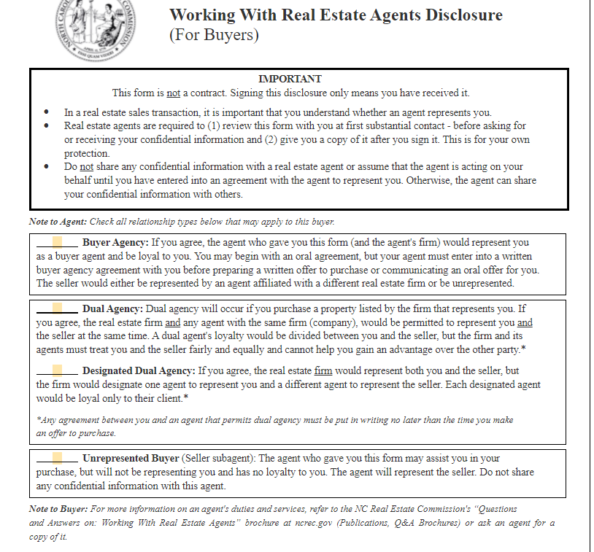
This form is NOT a contract
Please note this states
That you are the one
Checking the boxes
-Check the buyer agency
Box if not ROG listing,
-Check buyer AND dual
Agency if is ROG listing
Check designated if
Buyer is not ok with dual
Agency and wants sole
Representation
Check unrepresented if
Buyer refuses representation

Slide 8
Interviewing Before Offer A, B, C
A) This is a super important part. THE OFFER!!
At this point, you should have had the previous discussions with them about their priorities, finances, motivations, expectations, loan types, etc. You should understand your client’s needs and expectations at this point so that you can have meaningful conversations with them. They should feel VERY HEARD AND UNDERSTOOD by you at this point in the process. Due diligence, earnest money, closing costs and loans should be discussed in detail before a buyer signs any offer. Do you understand due diligence? Earnest money? Loans? You need to!
If you know that the home they are going to make an offer on does not meet their needs and they are only offering because they feel rushed, and they seem to be over-settling, you should NOT take the offer in that moment (until you have a discussion/interview with them). A PAUSE TO DISCUSS THE WHOLE PICTURE IS ONE OF THE MOST IMPORTANT CONVERSATIONS YOU CAN HAVE WITH YOUR BUYER.
Example: “Guys, lets talk about this for a second. I know we are in a tight market and we have to move quickly and decisively. However, I just want to make sure we are on the same page. You mentioned that the school district, master on main level and distance to your work were 3 of the super important things that your family needed (along with several other things). While this home certainly checks certain boxes, I want to make sure that the fact it is in a different school district, does not have a master on the main level and is further from your job than you wanted, is not something that you are going to regret tomorrow morning if you win the bid. How do you feel about this?”
Have the buyers visualize themselves winning the bid and have them envision how they will feel after they secure the property tomorrow morning. If there are doubts, suggest a break for them to discuss and then come back to it. It is better to walk away before the offer than after it has been accepted and they lose their dd money. Your buyers will appreciate these extra conversations about their decisions. Creating a brief pause to reconsider is sometimes all a buyer needs, to realize they don’t really want this home.
When you take care of your buyers in this manner, and they DO make an offer, they feel more secure with their decision and less likely to terminate. There should also be no confusion about due diligence or earnest money!

Slide 9
A… continued
If buyers decide to proceed with an offer you must discuss:
1) Restrictions, rights of way, easements, taxes, HOA dues. Make sure these items are in line with what they are expecting both practically and financially. Where do you find this information? Do you know?
2) Earnest money and due diligence money and what it means to them! Ask them questions to make sure they understand the due diligence will not be returned to them if they terminate. Make sure they understand if something shows up in inspections that they don’t like, and the seller wont fix it, they can terminate BUT they will NOT get their due diligence back. Same discussion and explanation about loss of earnest money.
3) Explain the inspections process, when you would order the inspections and how that process plays out during the due diligence period. What questions and concerns do they have about this?
Go over Form 760 and have them fill that out. Make sure they know that the seller is NOT required to repair anything at all, but we can ask and attempt to negotiate this. Ask if they have questions or concerns about this process!
Do the buyers have reasonable expectations? (In a seller’s market, sellers are NOT motivated to make repairs just because the buyer is under contract with their home. Is the buyer expecting the seller to cower to their demands? Does the buyer have plans to ask for tens of thousands in repairs after you are under contract? This is normally a set up for failure. You should have this discussion!
4) Call their lender while buyer is present, and ask about due diligence dates (will appraisal be done by then?), confirm closing date seems reasonable for the lenders timeline. Have a conference call if buyers aren’t present, Ask the buyers if they have questions for the lender while on phone? Make sure the buyers understand the property, the contract and the process before you finalize the contract! Always ask if they have questions or concerns that you can answer for them.
5) Have a frank discussion about closing dates getting moved sometimes. Make sure they know that the closing date could be moved with very little notice in the end and that you will be staying in touch with the lender and the buyer and will keep everyone informed if that should happen! Make sure they have a back up plan if the closing is moved or rescheduled!
6) Do they have to close on their home to purchase? Explain this process in detail! Are they in a rental? Make sure they can extend their rental date in the event the closing is moved.

Slide 10
B) Agency
You MUST reduce your buyer agency agreement to writing not later than the TIME OF THE OFFER!
Do you understand agency? Have you interviewed your buyers to find out what they want and need from a buyer agent? Are you providing that? Do you have a checklist that you follow? You should!
Can you explain the difference in buyer, dual, designated and unrepresented buyers/agency agreements? You should be able to!
Explain the Buyer Agency Agreement before you ask them to sign it. Learn how to explain it in an easy to understand manner.
Do you know the difference between Exclusive and NON Exclusive Buyer Agency Agreements? Can you explain them? You should be able to!
AGENCY

Slide 11
C…DISCLOSURES
DISCLOSURES
Buyers SHOULD review ALL disclosures prior to submitting offer
If you don’t have the disclosures FIND THEM! Call LA, BIC of the LA, look in MLS, ask for them BEFORE YOU SHOW THE PROPERTY! It is best to review disclosures while you are looking at the property in person AND PRIOR TO ANY OFFERS!
Make sure the disclosures are filled out. If there are parts not filled out, you should contact the LA and get clarity to those questions.
Verify all information in MLS. Verify city sewer, water, HOA dues (use the HOA form), square footage if necessary, heating and cooling, keep your eyes open for inconsistencies!
Go over all of this information with the buyer before they make their offer. If you provide a disclosure to a buyer after they have submitted an offer and the disclosure shows the heat pump is 30 years old and the roof is 30 years old, they may not be very happy!
disclosures

Slide 12
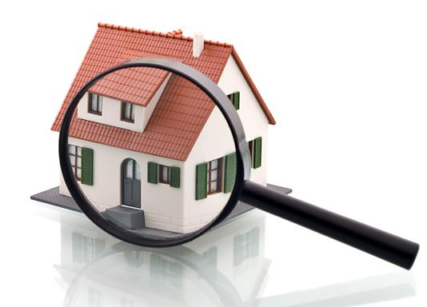
INSPECTIONS AND REPAIRS…
Form 760 is your friend
Contracts state that this is an AS IS SALE unless otherwise agreed to in writing, does the buyer know this? What does this actually mean? For the buyer? For the seller? Does your buyer understand this?
Do buyers understand that a seller does NOT have to make ANY repairs and that the buyer will LOSE their due diligence if they terminate for any reason or no reason?
Do buyers have realistic expectations about seller willingness to make repairs in this market? If not, explain it! Interview them and ask!
Do you understand the process from the contract to closing? Do you have a checklist? You should! Have you explained the overview of what to expect to your buyer? Do you have a list to give the buyer so that they can follow along what the next steps are? Create one….
Buyers have a right to be present during inspections (or a part of inspections) but YOU must be with your buyer if they want to be present for inspection. Talk to the buyer about this! Find out what they prefer.
If buyers have questions about inspections, who should answer that question?
Negotiating repairs, if seller agrees to repairs, make sure you require reputable repairmen or licensed contractors if applicable. Make sure you get the ddr signed BY BUYER AND SELLER prior to the end of dd.
Repairs must be done by closing NOT by end of dd.
You should also put on ddr that seller will provide written proof of repairs via invoices or statements from repairmen.
You can get an inspector to go back out after repairs are done and sign off on the repairs that they were done correctly (for a fee).
Certain loans require certain repairs, do you and your buyer understand this part and which loans?

Slide 13
CONTRACT TO CLOSE CHECKLIST EX.

Slide 14
FORM 760

Slide 15
FORM 760 CONT

Slide 16
FINAL WORDS ABOUT INTERVIEWS…
They should start in the very beginning with simple questions
After presenting the WWREA, you can start digging into more details to try and help buyer
I have found that buyers appreciate you explaining the process to them and letting them take part in deciding what is best for them
If you don’t understand agency, offers, disclosures, inspections, repairs, etc then you should reach out to me before you have a buyer, not just after!
You should role play these questions and interviews with other agents regularly to make sure you feel comfortable explaining the information
Your goal with the interviews/questions is to understand HOW you can best serve and help the buyer. Once you understand more about them, their situation and their goals, you can partner with them as a team to reach their goals!
The MORE you practice, the better and more confident you will get with this.

Slide 17
ANY QUESTIONS?

