Slide 1

Skyslope tip
Making the transition from zipforms to digisign simple

Slide 2
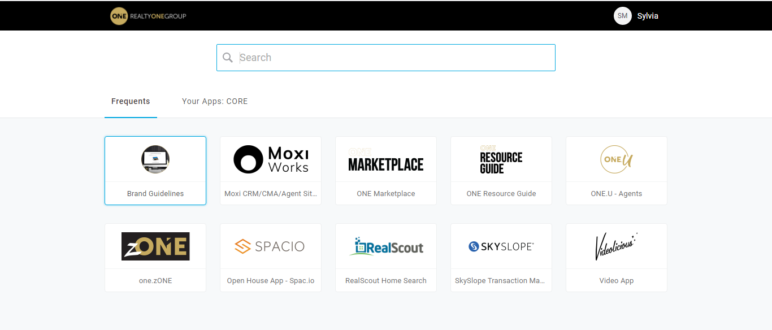
From your onelogin screen – click on skyslope

Slide 3
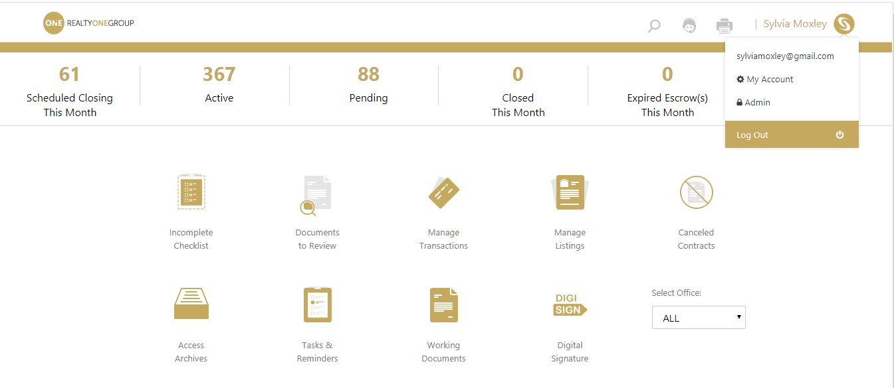
In skyslope – click on your name in the top right hand corner – click on my account

Slide 4
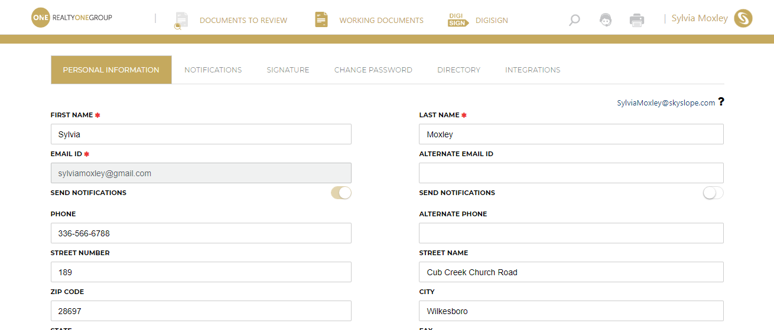
You have located your personal unique email address for skyslope – you can scan and email docs to this email address for a quick way to send through digisign without having to create a transaction

Slide 5
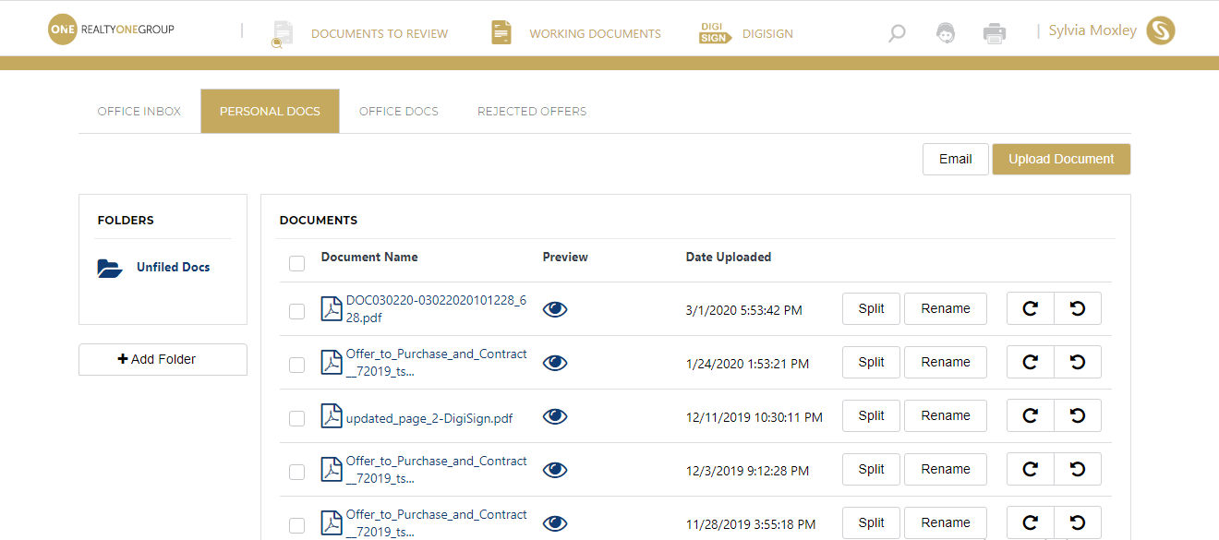
After emailing/scanning your docs into your unique skyslope email address – you can locate these docs by clicking on working documents – personal docs

Slide 6
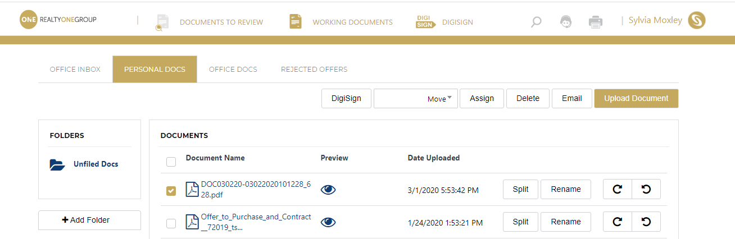
Click the box beside a document and you instantly gain access to send through digisign

