Slide 1
Dart
Feature rich, affordable GPS tracking device
The Dart is a compact and economical, yet feature rich GPS/GLONASS tracking device available in 2G or 3G.
FEATURES
High Sensitivity GPS with LNA
3D Accelerometer
Internal back-up Battery
1 x Ignition Input
2 x Digital Inputs
1 x Digital Output
Easy to Install and Conceal
Wired or Emulated Ignition Detection
Geo-fencing and Alerts
Plug-in 12 Wire Harness
Driver ID Support: RFID or iButton
APPLICATIONS
Vehicle and fleet tracking
Powered asset tracking
Run hour monitoring
Tax and FBT reporting
Scheduled maintenance reminders
Anchoring and security of assets
Rev 2.2 – 4th Oct 2018

Slide 2
MECHANICAL SPECIFICATIONS
Compact Housing | The ABS plastic housing clips together to make provisioning devices simple and efficient
Dimensions | L 95 x W 55 x H 17mm
Operating Temperature | -20°C to +60°C¹ On external power Below 0°C and above +40°C the internal backup battery will not be charged as a safety precaution due to the dangers associated with charging batteries at extreme temperatures.
Harness | 12 Pin Wiring Harness (included) OBDII Harness (optional) Cigarette Lighter Harness (optional)
POWER
Input Voltage | 8V to 36V DC (max)
Operating Current | 10mA avg. (battery fully charged) 145mA avg. (battery charging)
Sleep Current | <1mA
Back-up Battery | 200mAh LiPo internal backup battery pack
Self-resetting fuse | The Dart passes stringent automotive power “load dump” tests to ensure that it will continue to operate in the harshest electrical systems. A built-in self-resetting fuse makes installation easy and safe.
OTHER
Internal Memory | Sufficient memory to store over 50,000 records. Normally data is sent to the server immediately but if the device is out of range there is space to ensure no data is lost – for many weeks of driving!
3-axis accelerometer | Allows the Dart to detect harsh driving events, and to go to ‘sleep’ when not moving, resulting in extremely low standby current
CONNECTIVITY
SIM Size | Standard (2FF) size cellular SIM card
2G, 3G or 4G | The Dart can be manufactured for specific markets around the world with cellular modem modules approved by all the major networks.
 | 2G Modem | Quad Band GSM/GPRS Class 10 850/900/1800/1900 MHz
 | 3G Modem - EU | 850/900/2100 EMEA/APAC/Latin America
 | 3G Modem - NA | 850/1900/AWS - North America
 | 3G Modem (Global Option) | 800/850/900/AWS/1900/2100 Global coverage at a higher cost
 | Enquire for other bands and 4G/LTED options 4G LTE-CatM1/Nb-IoT model currently in development

Slide 3
GPS TRACKING
GPS and Cellular Antenna | Internal GPS and cellular antennas tuned by RF laboratories for optimal performance. Having the antennas inside the housing makes for very simple and quick installation.
GPS/GLONASS tracking | Concurrent GPS and GLONASS tracking 72 channel high sensitivity receiver -169dBM industry leading tracking performance
AssistNow Offline | AssistNow Offline aiding data or extremely fast time-to-first-fix and performance in urban canyon environments
Low Noise GPS Amplifier (LNA) | GPS signals are boosted by a special low-noise amplifier (LNA). This allows operation where normal units will fail to receive GPS signal
Switched Power Out | The Dart can provide power to external sensors and devices via this power line, allowing for easy installation and doing away with the need for additional external power supplies. Voltage: 3.5V to 4.5V Maximum current: 200mA
Driver Identification | Driver ID via RFID reader or iButton The Dart can be update from the server with lists of Drivers that are allowed to drive the vehicle. The Dart can be installed to immobilise a vehicle and only allow authorised drivers/operators to drive it.
FIRMWARE SMARTS
Auto-APN | Auto-APN allows the Dart to analyse the SIM card and select the correct APN details from a list that is pre-loaded in the device’s firmware.
Multi-APN | The Dart can be configured to roam across multiple networks and automatically use the different APN details for the roaming networks
Text Message Setup | The Dart can be sent text messages to set the APN, server and other details
Fleixible Logging Parameters | The Dart trip logging is flexible and can be configured to log based on a variety of parameters including: Elapsed time, Distance travelled, Change in heading, Change in speed, On Stationary, Accelerometer events (harsh driving)
Accident and Rollover Detection | The Dart uses the built-in accelerometer to detect high G impacts such as accidents and rollovers and reports these events to the server for emergency alerting.
INPUTS AND OUTPUTS
Ignition | Ignition digital input 0-48V DC 5V on/off threshold
2 x Digital Inputs | 2 x digital inputs with configurable pull-up/down 0-48V DC input range On/Off thresholds: Pull-up enabled: low at 0.8V, high at 1.0V Pull-down enabled: low at 2.0V, high at 2.4V
1 x Digital output | 1 x switched ground digital output, easily wired up to switch external lights, relays, buzzers etc. Can be used to immobilize a vehicle

Slide 4
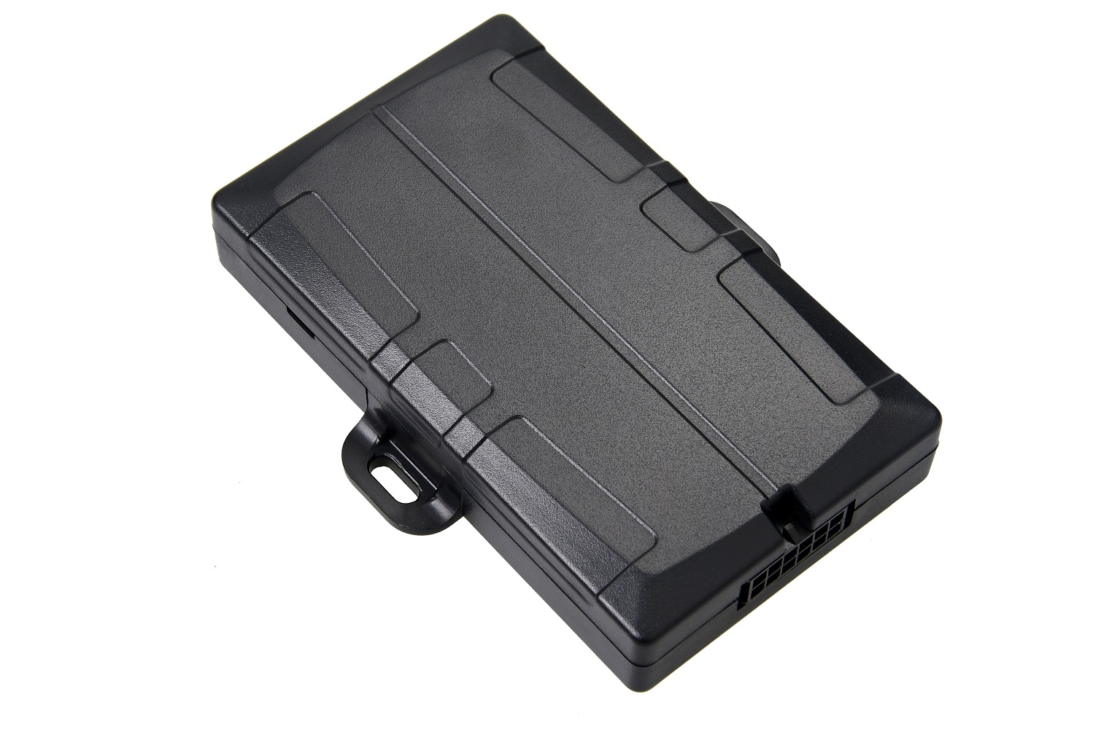
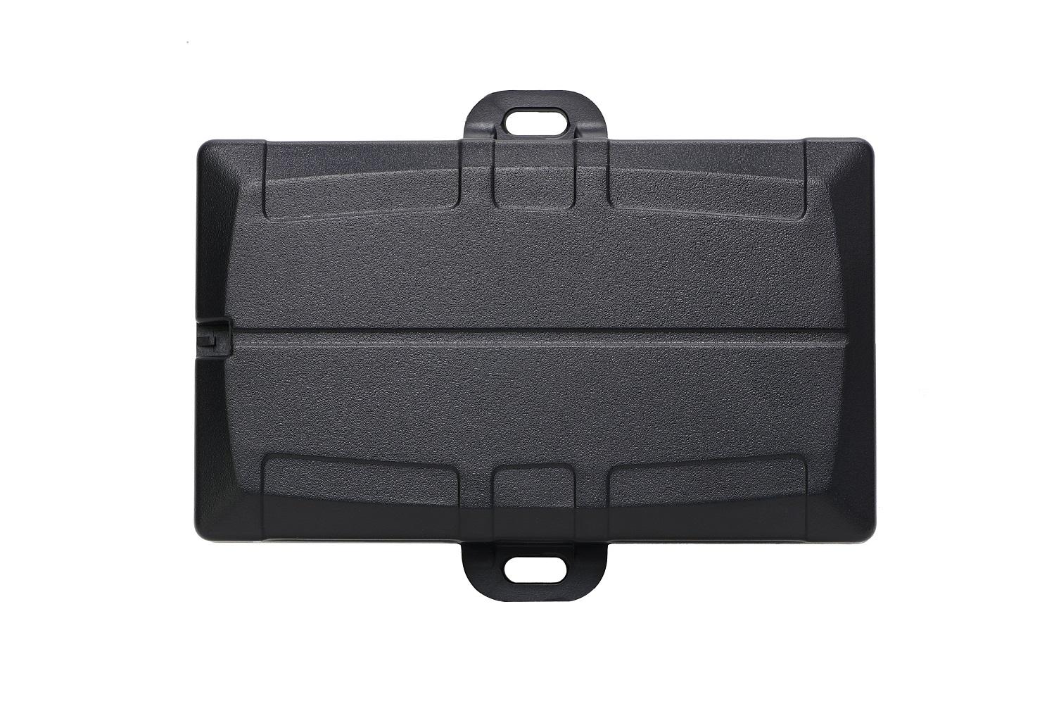
Harsh Driving | The Dart automatically calibrates its built-in 3 axis accelerometer and uses this to detect harsh driving events: Excessive acceleration Harsh braking Cornering at speed These events are logged in the Dart along with additional event statistics that allow back-end server platforms to perform sophisticated driver profiling and scoring.
Accident Data | The Dart keeps a second-by-second “black box” recording of valuable GPS and accelerometer data for a two hour window. This data can be automatically uploaded to the server when an accident is detected, or it can be requested manually.
Geo-Fences | The Dart has the capacity to hold hundreds of geo-fences. A future firmware update will enabled the Dart to download geo-fences from the server. The Dart could use this geo-fence information to: Implement arrival and departure alerts Implement speeding zones with audible warning alerts Implement “No-go” and “Keep-out” areas Automatically control outputs, e.g. to switch on warning lights when inside a special area.
Ignition Detection | The Dart can determine a trip has started based upon: Wired Ignition input (voltage on/off) Emulated Ignition (GPS movement) Run Detect (Voltage Increases)
CERTIFICATIONS
Certifications | CE, RCM, ICASA

Slide 5
Version | Date | Changes
2.0 | 31/8/18 | New format with datasheet info
2.1 | 12/9/18 | Increased font and extended to 3pgs
2.2 | 4/10/18 | Changed Geofence Wording

