Slide 1
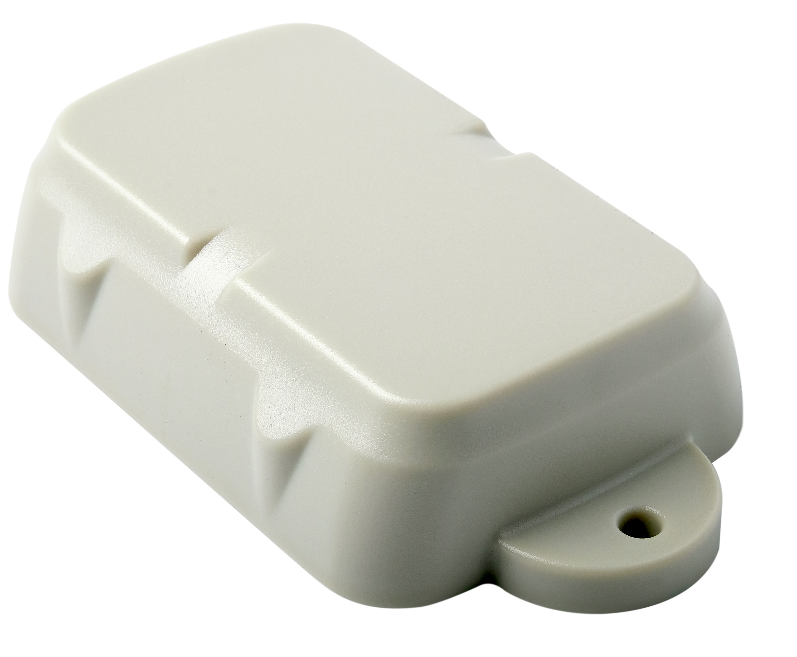
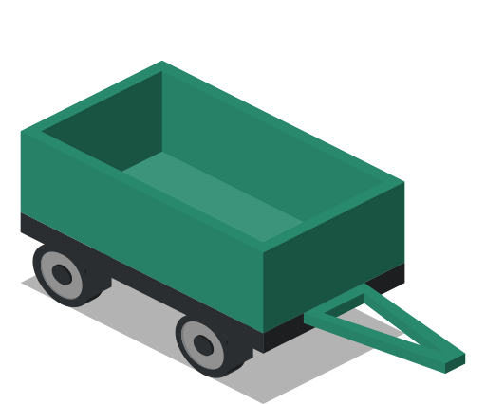
Oyster 2G/3G Cellular
Battery-Powered, IP67 Rated, Compact GPS Asset Tracker
The Oyster is a rugged, waterproof, cellular GPS tracking device designed for tracking non-powered, exposed assets where super-long battery life is essential.
FEATURES
Up to 4 years once daily location
Up to 1 year detailed tracking
IP67 water and dust proof
Rugged, robust and low profile
Off-the-shelf, replaceable Lithium AA batteries
No install required, simply “place ‘n trace”
Switch from “locate” to “track” over-the-air
Battery status and low battery alert
Unauthorised movement alert
Integrated accelerometer
APPLICATIONS
Vehicle and fleet tracking
Non-powered asset tracking
Equipment locate and recovery
Trailers and mobile assets
Shipping containers and freight
Anchoring and security of assets
Rev 2.1 – 27th Sept 2018
www.digitalmatter.com

Slide 2
MECHANICAL SPECIFICATIONS
Low-profile IP67 rugged housing | The IP67 rated housing is made of sturdy ABS/Polycarbonate plastic to survive bumps and knocks and to survive many years in the sun and weather. It’s low profile together with mounting tabs and ‘strap slots’ allow for easy mounting.
Dimensions | L 137 x W 72 x H 30mm
Operating Temperature | -20°C to +60°C¹ For operation in extreme temperatures, the Oyster must be fitted with Lithium batteries. Batteries are affected by temperature extremes and typical performance is dependent on temperature
POWER
3 x AA Batteries | The Oyster uses 3 x “AA” size 1.5V Lithium Batteries. These are readily available from retail outlets, for example Energizer Ultimate Lithium.
Sleep Current | 10uA (micro amps)
Maximum Input Voltage | 6V Max, no reverse input protection
OTHER
Flash Memory | Sufficient memory to store over 25,000 records. Normally data is sent to the server immediately but if the device is out of range there is space to ensure no data is lost. A future firmware version will allow for geo-fences to be loaded into the flash memory of the device and used for geo-fence alerting on the device.
3-axis accelerometer | The 3-axis accelerometer allows the Oyster to ‘sleep’ in an ultra-low power state yet still wakeup when movement occurs. Future firmware versions will allow for harsh G-force detection (like assets being dropped or involved in accidents)
CONNECTIVITY
SIM Size | Micro (3FF) size cellular SIM card
2G, 3G or 4G | The Oyster can be manufactured for specific markets around the world with cellular modem modules approved by all the major networks.
2G Modem | Quad Band GSM/GPRS Class 10 850/900/1800/1900 MHz
3G Modem – EU | 850/900/2100 EMEA/APAC/Latin America
3G Modem – NA | 850/1900/AWS North America
Other | Enquire for other bands and LTE/4G options. 4G LTE-CatM1/Nb-IoT model currently in development.
GPS TRACKING
GPS and Cellular Antenna | Internal GPS and cellular antennas tuned by RF laboratories for optimal performance.
GPS/GLONASS tracking | UBLOX MAX-M8Q GPS Module Concurrent GPS and GLONASS tracking 72 channel high sensitivity receiver -167dBM industry leading tracking performance
AssistNow Offline | AssistNow Offline aiding data for extremely fast time-to-first-fix and performance in urban canyon environments
Low Noise GPS Amplifier (LNA) | GPS signals are boosted by a special low-noise amplifier (LNA). This allows operation where normal units will fail to receive GPS signal – like in a container stack!
www.digitalmatter.com

Slide 3
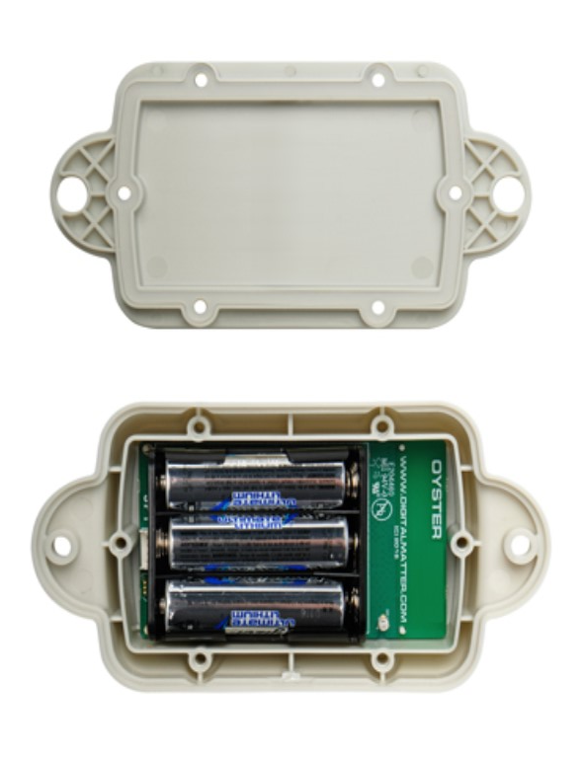
FIRMWARE SMARTS
OTA Configuration | The Oyster can be remotely configured and updated OTA (over the air). Device management is performed from Digital Matter’s OEM Server device management platform.
Auto-APN | Auto-APN allows the Oyster to analyse the SIM card and select the correct APN details from a list that is pre-loaded in the device’s firmware.
Multi-APN | The Oyster can be configured to roam across multiple networks and automatically use the different APN details for the roaming networks
Text Message Setup | The Oyster can be sent text messages to set the APN, server and other details
Recovery Mode | The Oyster can be remotely switched into Recovery Mode which switches the device to do live tracking and reporting – so that you can get your asset back!
G-Force Events | A future firmware version will allow for harsh G-force detection (like assets being dropped or involved in accidents) and report these to the server.
Geo-Fences | The Oyster has the capacity to hold hundreds of geo-fences that can be downloaded to it from the server and updated Over-The-Air. A future firmware version will allow the Oyster to use this geo-fence information to implement geo-fence based alerting on the device.
Adaptive Tracking | The Oyster can be set to use Adaptive-Tracking technology where the accelerometer and GPS data are used to intelligently work out if it is moving and to send frequent updates, and to scale the update rate down to once per day if the asset is stationary - to preserve battery life.
CERTIFICATIONS
Certifications | CE, FCC, PTCRB, Canada, RCM, ICASA
www.digitalmatter.com

Slide 4
Version | Date | Changes
2.0 | 5/9/18 | New format with datasheet info
2.1 | 27/9 | Added Max input Voltage

