Slide 1
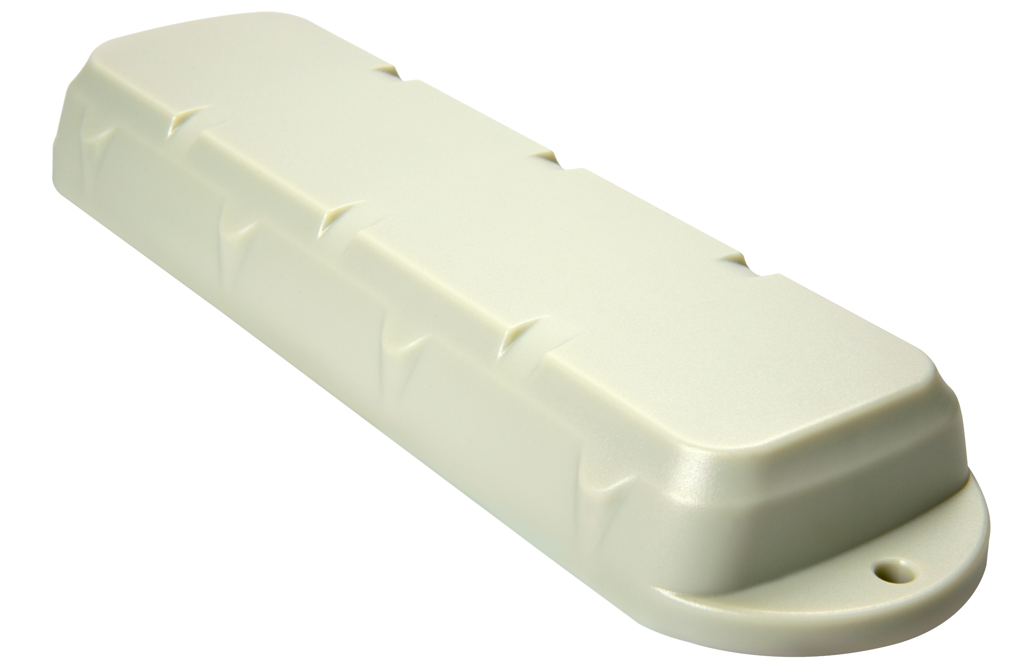
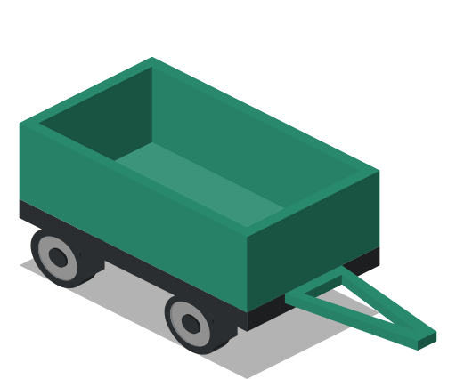
Remora
Battery-Powered, IP67 Easy-Install GPS Tracking Device
The Remora is a low-profile, rugged 2G or 3G GPS device designed for tracking non-powered assets where super-long battery life is required without sacrificing the frequency of updates and accuracy performance.
FEATURES
Up to 5 years once daily location
Up to 2 years detailed tracking
No install required, simply “place ‘n trace”
IP67 water and dust proof
Rugged, robust and low-profile
Switch from "locate" to "track" over-the-air
Magnetic tamper detection (optional)
Unauthorised movement alert
Integrated accelerometer
Limited speed alerts
High-G Event Detection
APPLICATIONS
Vehicle and fleet tracking
Non-powered asset tracking
Run hour monitoring
Trailers and mobile assets
Shipping containers and freight
Anchoring and security of assets
digitalmatter.com
Rev 2.2 – 13 November, 2018

Slide 2
MECHANICAL SPECIFICATIONS
Low-profile IP67 rugged housing | The IP67 rated housing is made of sturdy ABS/Polycarbonate plastic to survive bumps and knocks and to survive many years in the sun and weather. Itis low-profile making it easier to mount in the corrugation on containers or concealed on the underside of a trailer – for example. The housing screws together for easy assembly, and has 2 convenient mounting tabs. It also has ‘strap slots’ allowing the Remora to be cable tied or metal strapped to an asset.
Dimensions | L 225 x W 65 x H 30mm
Operating Temperature | -20°C to +60°C¹ 1. Specfication given is for the electronics. Check the specification of the batteries that will be used. For extreme temperatures, consider fitting LTC batteries instead of Alkalines
POWER
4 x C-Cell Batteries | The Remora uses standard “C-Cell” size batteries
Alkaline Battery option | Low cost off-the-shelf alkaline batteries can be used in the Remora
LTC Battery option | For applications that require extreme temperature or extra long-life Lithium-Thionyl-Chloride (LTC) batteries can be used. Ensure they will supply a high enough pulse current – see here: Remora Battery Recommendations
Sleep Current | 5µA (yes, that is micro-amps)² 2 At room temperature in the lowest power state.
OTHER
Internal Memory | Sufficient memory to store over 55,000 records. Normally data is sent to the server immediately but if the device is out of range there is space to ensure no data is lost. A future firmware version will allow for geo-fences to be loaded into the flash memory of the device and used for geo-fence alerting on the device.
3-axis accelerometer | The 3-axis accelerometer allows the Remora to ‘sleep’ in an ultra-low power state yet still wakeup when movement occurs. The accelerometer can also be used to detect extreme G-Force events such as an accident or abuse of the asset, for example dropping a container.
Magnetic Tamper Detect | Optional magnetic wireless tamper switch detects when the device has been removed from the asset.
CONNECTIVITY
SIM Size | Standard (2FF) size cellular SIM card
2G, 3G or 4G | The Remora can be manufactured for specific markets around the world with cellular modem modules approved by all the major networks.
 | 2G Modem | Quad Band GSM/GPRS Class 10 850/900/1800/1900 MHz
 | 3G Modem - EU | 850/900/2100 EMEA/APAC/Latin America
 | 3G Modem - NA | 850/1900 North America
 | Enquire for other bands and 4G options. 4G LTE-CatM1/Nb-IoT model currently in development.

Slide 3
GPS TRACKING
GPS and Cellular Antenna | Internal GPS and cellular antennas tuned by RF laboratories for optimal performance.
GPS/GLONASS tracking | UBLOX MAX-M8Q GPS Module Concurrent GPS and GLONASS tracking 72 channel high sensitivity receiver -167dBM industry leading tracking performance
AssistNow Offline | AssistNow Offline aiding data for extremely fast time-to-first-fix and performance in urban canyon environments
Low Noise GPS Amplifier (LNA) | GPS signals are boosted by a special low-noise amplifier (LNA). This allows operation where normal units will fail to receive GPS signal – like in a container stack!
Recovery Mode | The Remora can be remotely switched into Recovery Mode which switches the device to do live tracking and reporting – so that you can get your asset back!
G-Force Events | The Remora can detect harsh G-force events (like assets being dropped or involved in accidents) and report these to the server.
Geo-Fences | The Remora has the capacity to hold hundreds of geo-fences that can be downloaded to it from the server and updated Over-The-Air. A future firmware version will allow the Remora to use this geo-fence information to implement geo-fence based alerting on the device.
Adaptive Tracking | The Remora can be set to use Adaptive-Tracking technology where the accelerometer and GPS data are used to intelligently work out if it is moving and to send frequent updates, and to scale the update rate down to once per day if the asset is stationary - to preserve battery life.
Performance Monitoring | Track how the Remora is using its power with intelligent performance counters. Monitor wakeups, GPS fixes, uploads and more to understand exactly what the device is doing.
FIRMWARE SMARTS
OTA Configuration | The Remora can be remotely configured and updated OTA (over the air). Device management is performed from Digital Matter’s OEM Server device management platform.
Auto-APN | Auto-APN allows the Remora to analyse the SIM card and select the correct APN details from a list that is pre-loaded in the device’s firmware.
Multi-APN | The Remora can be configured to roam across multiple networks and automatically use the different APN details for the roaming networks
Text Message Setup | The Remora can be sent text messages to set the APN, server and other details
CERTIFICATIONS
Certifications | CE, FCC, PTCRB, Canada, RCM, ICASA

Slide 4
Version | Date | Changes
2.0 | 5/9/18 | New format with datasheet info
2.1 | 17/9/18 | Changed table layout slightly
2.2 | 13/11/18 | Added link to battery recommendations

