Slide 1


Slide 2
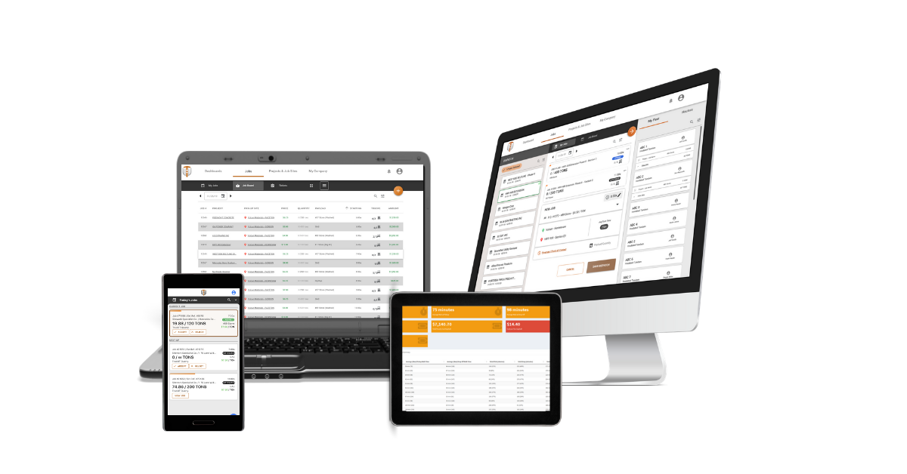
Welcome to TruckIT
It’s All About You.
We realize we only have one chance to make a good impression and win you over. Which is why our team of pros makes you a priority knowing your success is our success. Our objective is to remove roadblocks and automate manual processes making our technology is easy to use and effective. This frictionless approach lets you move faster and focus on the task at hand so you can do more with less work.
Without help onboarding your left to figure things out on you’re own. The following quick-start guide will have you up and running quickly so your team is able to maximize the value of the TruckIT Web Portal and Mobile App.
Quick-Start | TABLE OF CONTENTS
Onboarding Introduction
My Company | Set-Up
TruckIT Mobile App Download
TruckIT Web Portal Training
TruckIT Mobile App Training
Appendix
CUSTOMER SUCCESS
(404) 990-4233
SUPPORT@TRUCKIT.COM

Slide 3

Portal
COMPANY SET-UP

Slide 4
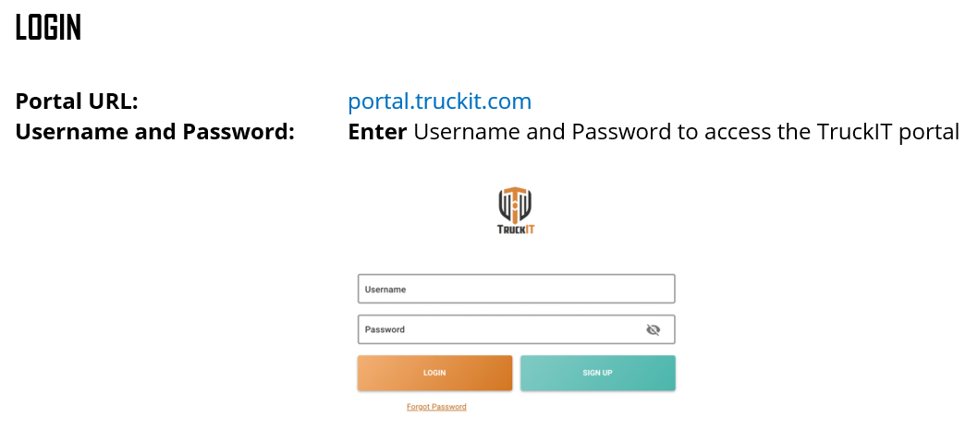



MY COMPANY
Users, Trucks & Drivers
TruckIT Web Portal
Once you have created a Username and Password, you’re ready to login to the TruckIT portal and begin setting up your company on the My Company page.
MY COMPANY
Now that you have successfully logged into the TruckIT portal, you will go to the My Company page to set-up your company. There are three tabs on this page for you to add trucks to your fleet, add drivers/dispatchers to your team, and complete your company profile with settings for job filters and preferred notifications.
My Company Checklist:
My Fleet allows you to add and delete trucks to your fleet
My Team allows you to add and delete users (drivers and dispatchers)
In Settings, you provide your COI and payment information and set your job filters and preferred notifications.

Slide 5
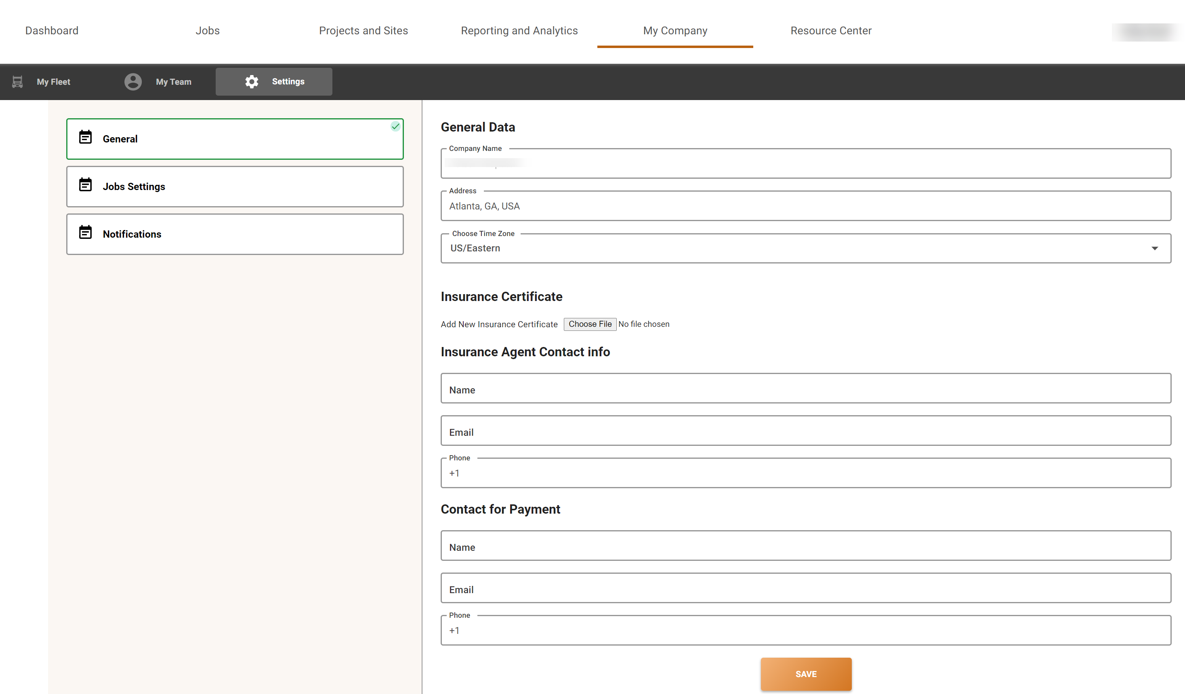
My Company
Set-Up
Complete your company profile with settings:
General Data
COI Info
Payment Contact
Set-Up settings for job filters
Preferred notifications

Slide 6
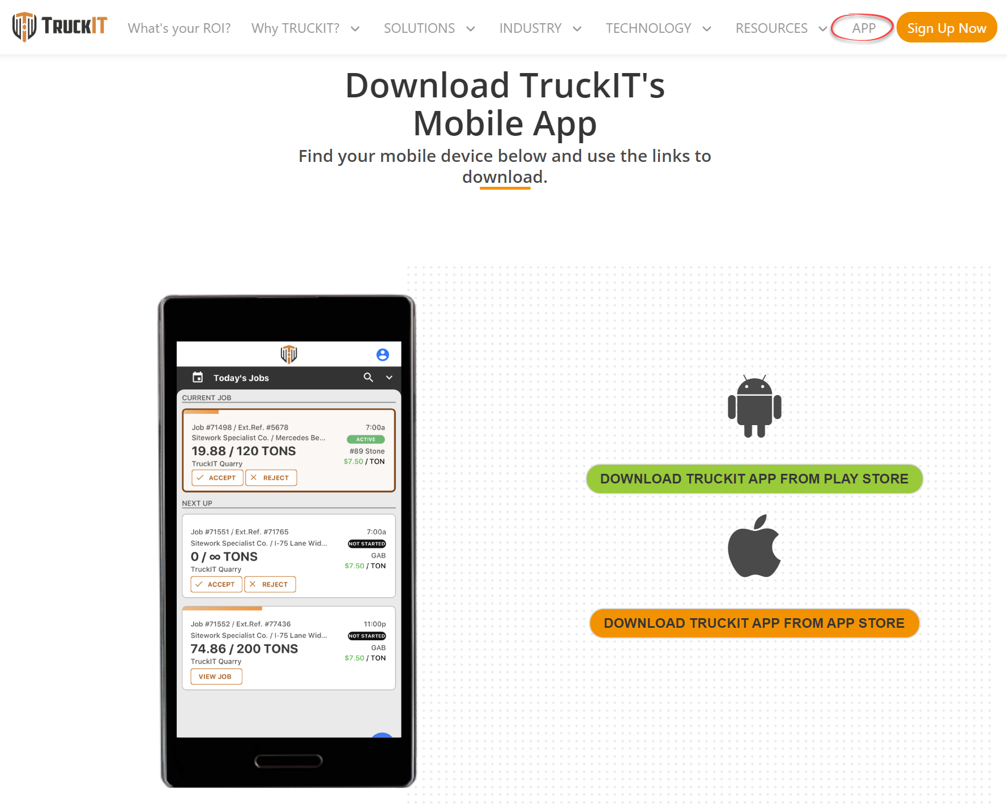




TruckIT MOBILE APP
DOWNLOAD
Two easy options to download the TruckIT App
Go towww.truckit.com/app
to download the TruckIT App for Android and Apple devices.
Download the TruckIT App from the Google Play and App Store.

Slide 7
Portal
Training supplement

Slide 8

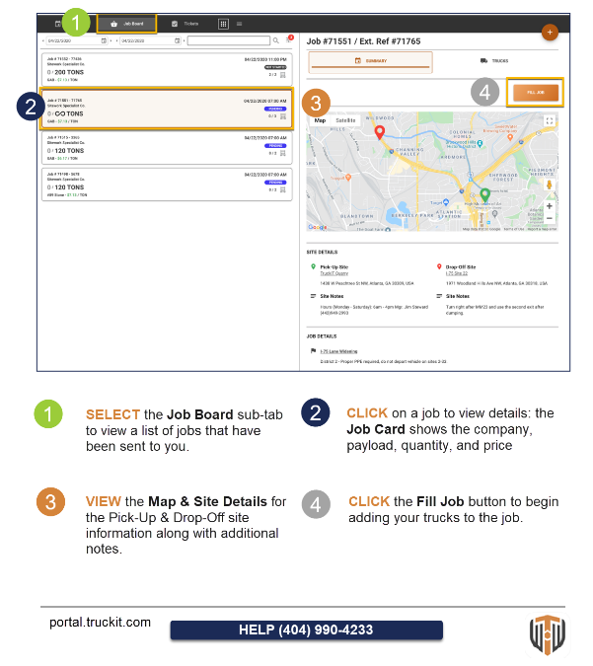
STEP by STEP Portal Training Supplement provided by TruckIT:
USERS:
Management/Operations
Dispatchers
Back-office
PORTAL TABS:
DASHBOARD
JOBS
PROJECTS & SITES
REPORTING & ANALYTICS
MY COMPANY

Slide 9

What’s in it for me……..
        Dispatching efficiency
        Reduction in time spent dispatching
        Time save reconciling tickets
        Order accuracy
        No more lost loads or lost tickets
        Health & Safety
Since our switch, we have seen a marked improvement in our supply process. Total daily tonnage shipped per truck has increased 20%-30%. Scheduling, speed and accuracy of delivery, invoice reconciliation and process controls have all been greatly streamlined.
-Heavy Civil Highway Contractor

Slide 10
Portal
In-App training resources

Slide 11
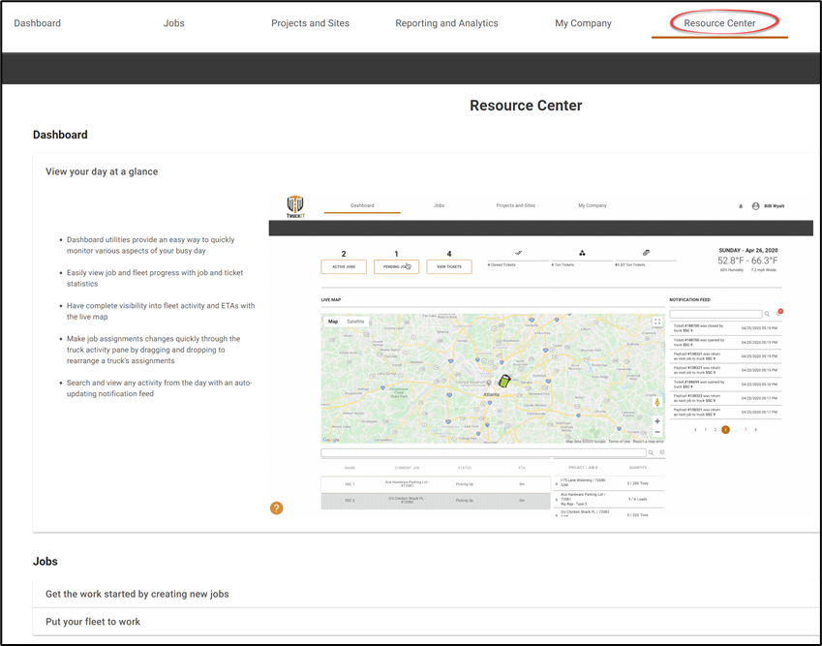
Training Resources
Now that you have created a Username and Password, you’re ready to Login and begin using the TruckIT Web Portal.
We want you to be operating at full-speed, so we’ve created an arsenal of training resources suited to different learning styles. TruckIT training is always at your fingertips in our Help and Resource Centers which includes; workflow guides, tool tip icons, video tutorials and gifs.
Resource Center
Instead of lengthy webinars, we have animated gifs and concise on-demand video tutorials for the Web Portal and Mobile App. The gif’s are categorized by each portal tab so you can easily locate workflows for assistance.

Slide 12
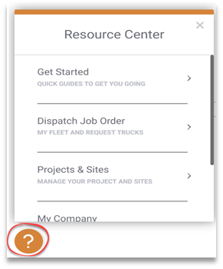

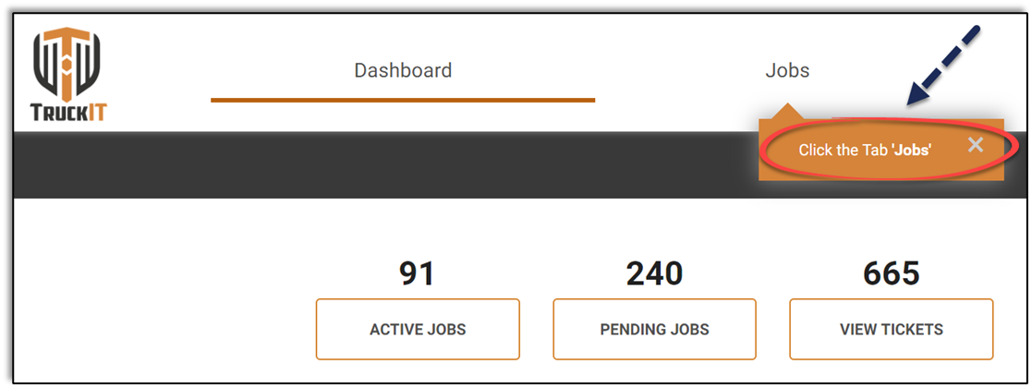
TRAINING RESOURCES
Continued
Additional Resources
Additional resources are available by clicking the orange question mark icon located at the lower
left-hand corner of your screen.
Workflow Guides
Workflow guides walk you through the necessary steps to perform
tasks in the portal by highlighting tabs, buttons and data fields.

Slide 13
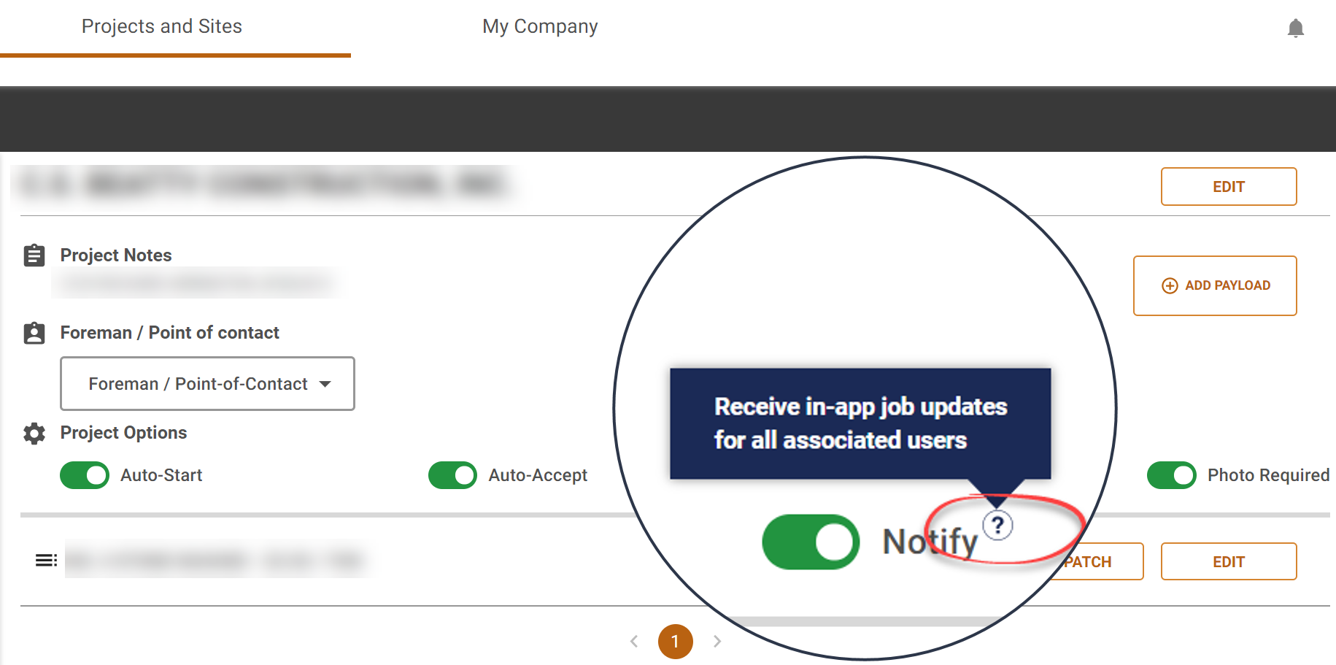
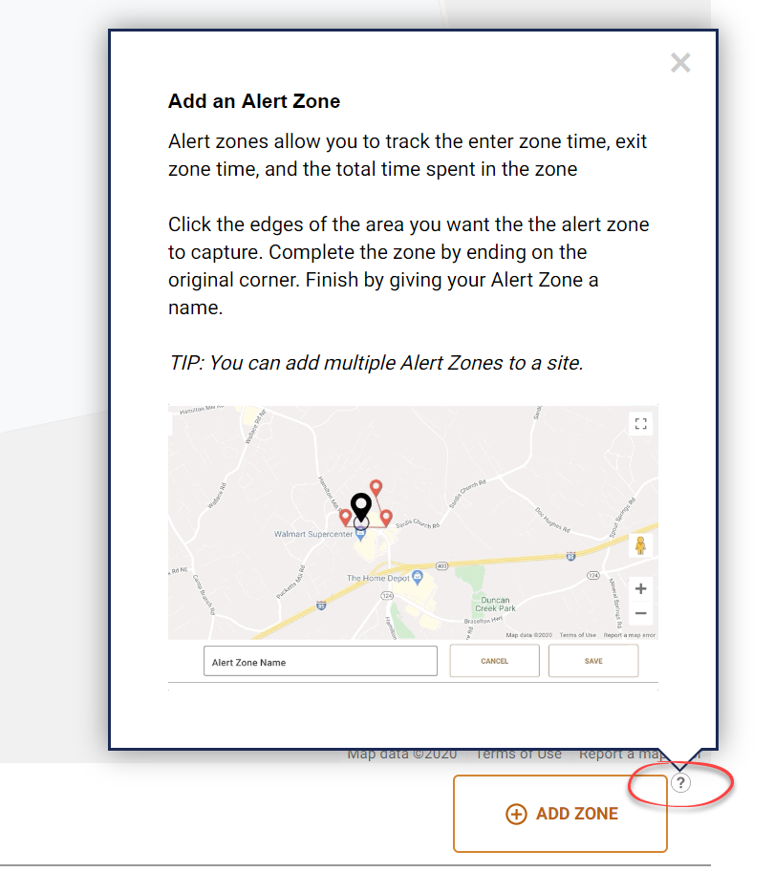
TRAINING RESOURCES
Continued
Tool Tip Icons
There are question mark icons strategically located within the portal.
When hovering over the question mark icons, Tool Tip bubbles will appear explaining the button or icon and related the workflow.
For more complex tasks, the bubble will include gif’s and PRO TIPS.

Slide 14
mobile app
Training supplement

Slide 15
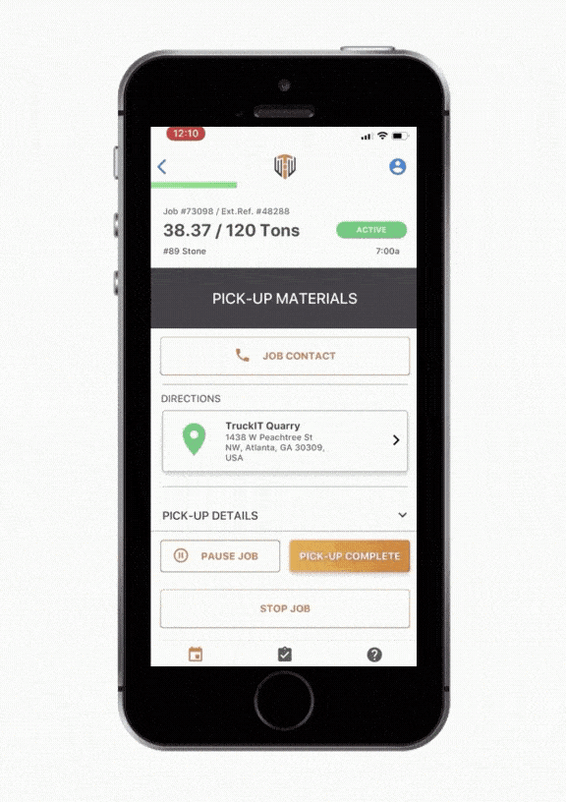
TRUCKIT MOBILE APP
Features and Functionality
Dispatched jobs delivered to drivers via the TruckIT app.
My Jobs
  Map
  Site Details
  Job Details
  Pick-Up & Drop-Off Details
My Tickets
  Daily Tickets – Closed & Open
Notifications
  New & Unread
Profile & Settings
  Contact Info
  Link Management
  Suspend Location
  Log-Out
TruckIT Support
  In-App | On Call Support
Features
  Pause Job
  Change Job
  Site Contact
  TicPic
  View Tickets

Slide 16
TRUCKIT MOBILE APP
DRIVER Overview
What’s in it for me……..
        More loads per day per driver
        Increase in tons per day per truck
        Increase in pay per driver
        No more lost loads or lost tickets
        Driver safety
The Mobile app works flawlessly. The recent updates were subtle but really made a huge difference in the user experience. I can see tonnage delivered on big orders in real-time and I can easily close tickets immediately when I drop-off material. This is officially a Bad A** App!
Larry W. Hall
C4 Hauling Inc.

Slide 17
Driver handout

Slide 18
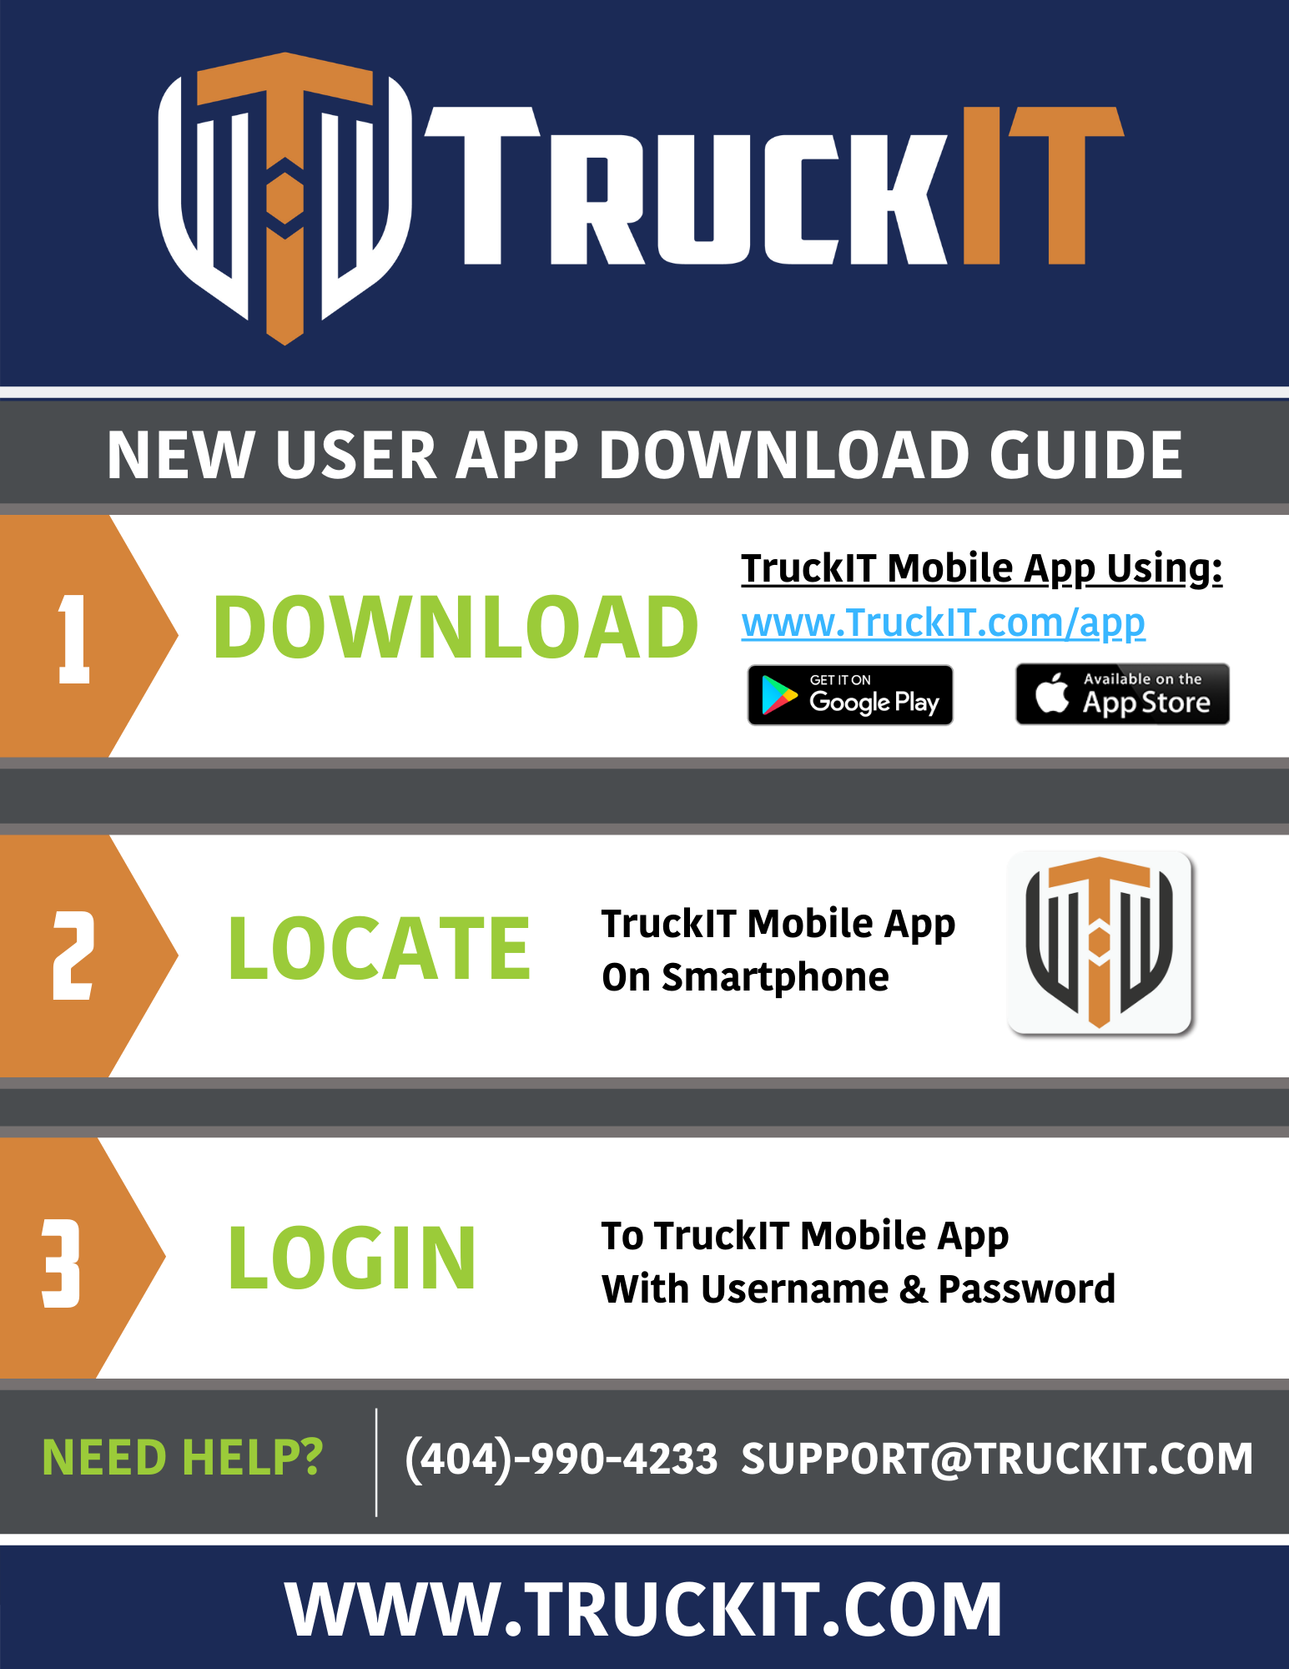

Slide 19
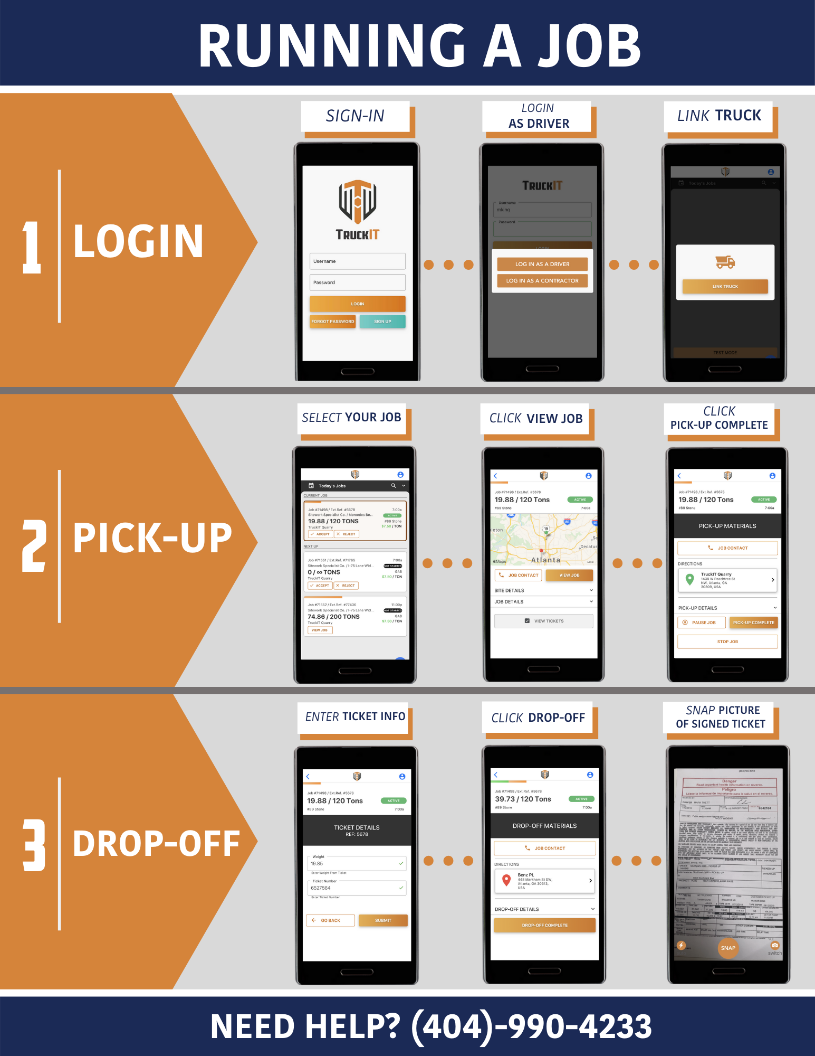

Slide 20
APPENDIX
Contact Us
FAQ
Certificate of insurance
Data Security

Slide 21
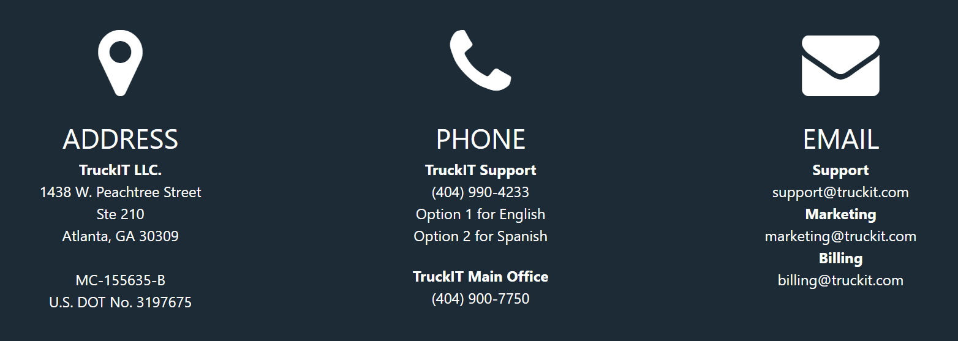


CONTACT US
For TruckIT and Industry news and updates follow us on social media and the TruckIT blog.
https://blog.truckit.com/
User feedback carries incredible influence and weight, so TruckIT appreciates your input as we are always striving to enhance our products for you.

Slide 22
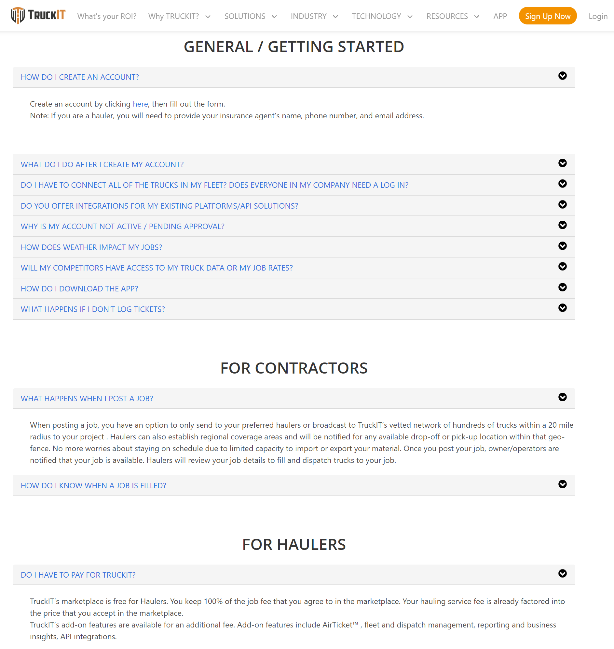
FAQ
Common Questions
LINK: https://www.truckit.com/faqs/

Slide 23
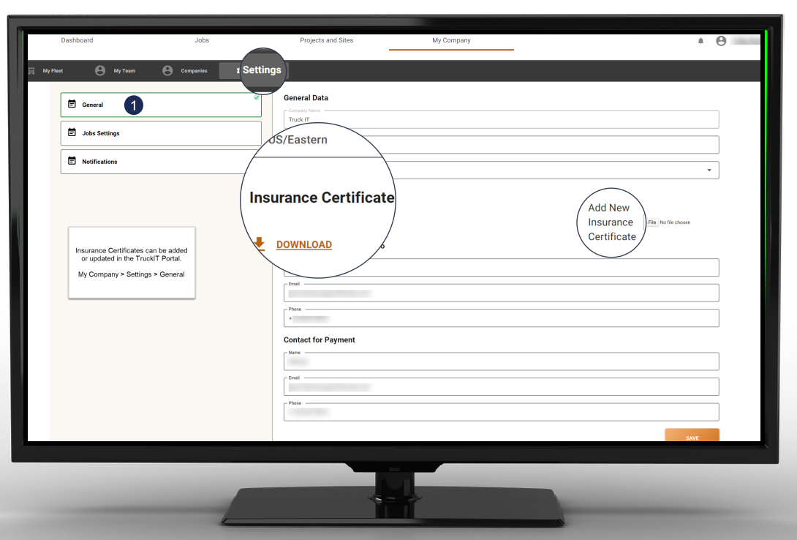
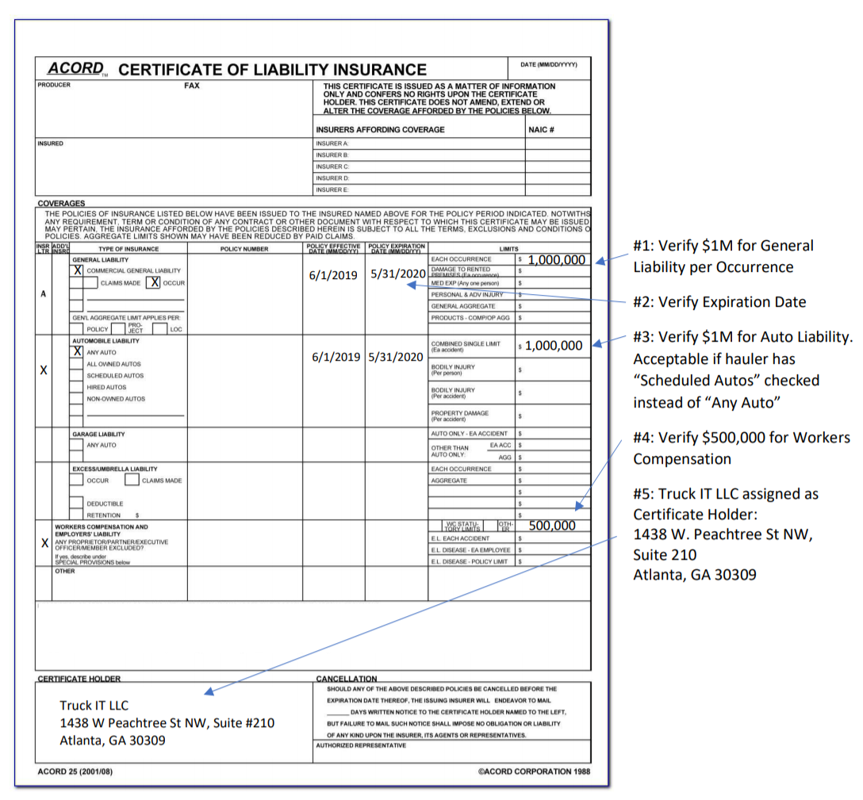
COI’S
Renewals or updates to your Certificate of Insurance can be uploaded and stored on your My Company Page.
Alternatively, you can send via email to:
insurance@truckit.com
COI Requirements:

Slide 24
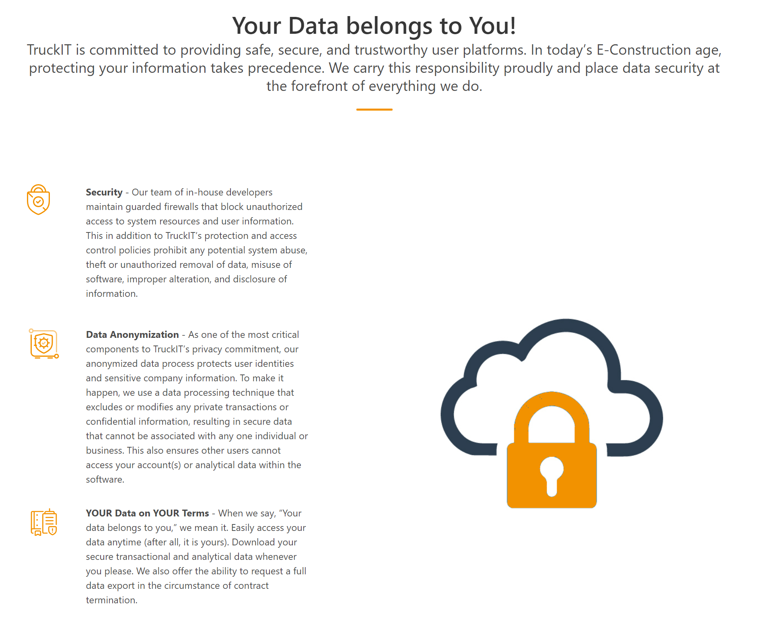

DATA SECURITY

Slide 25
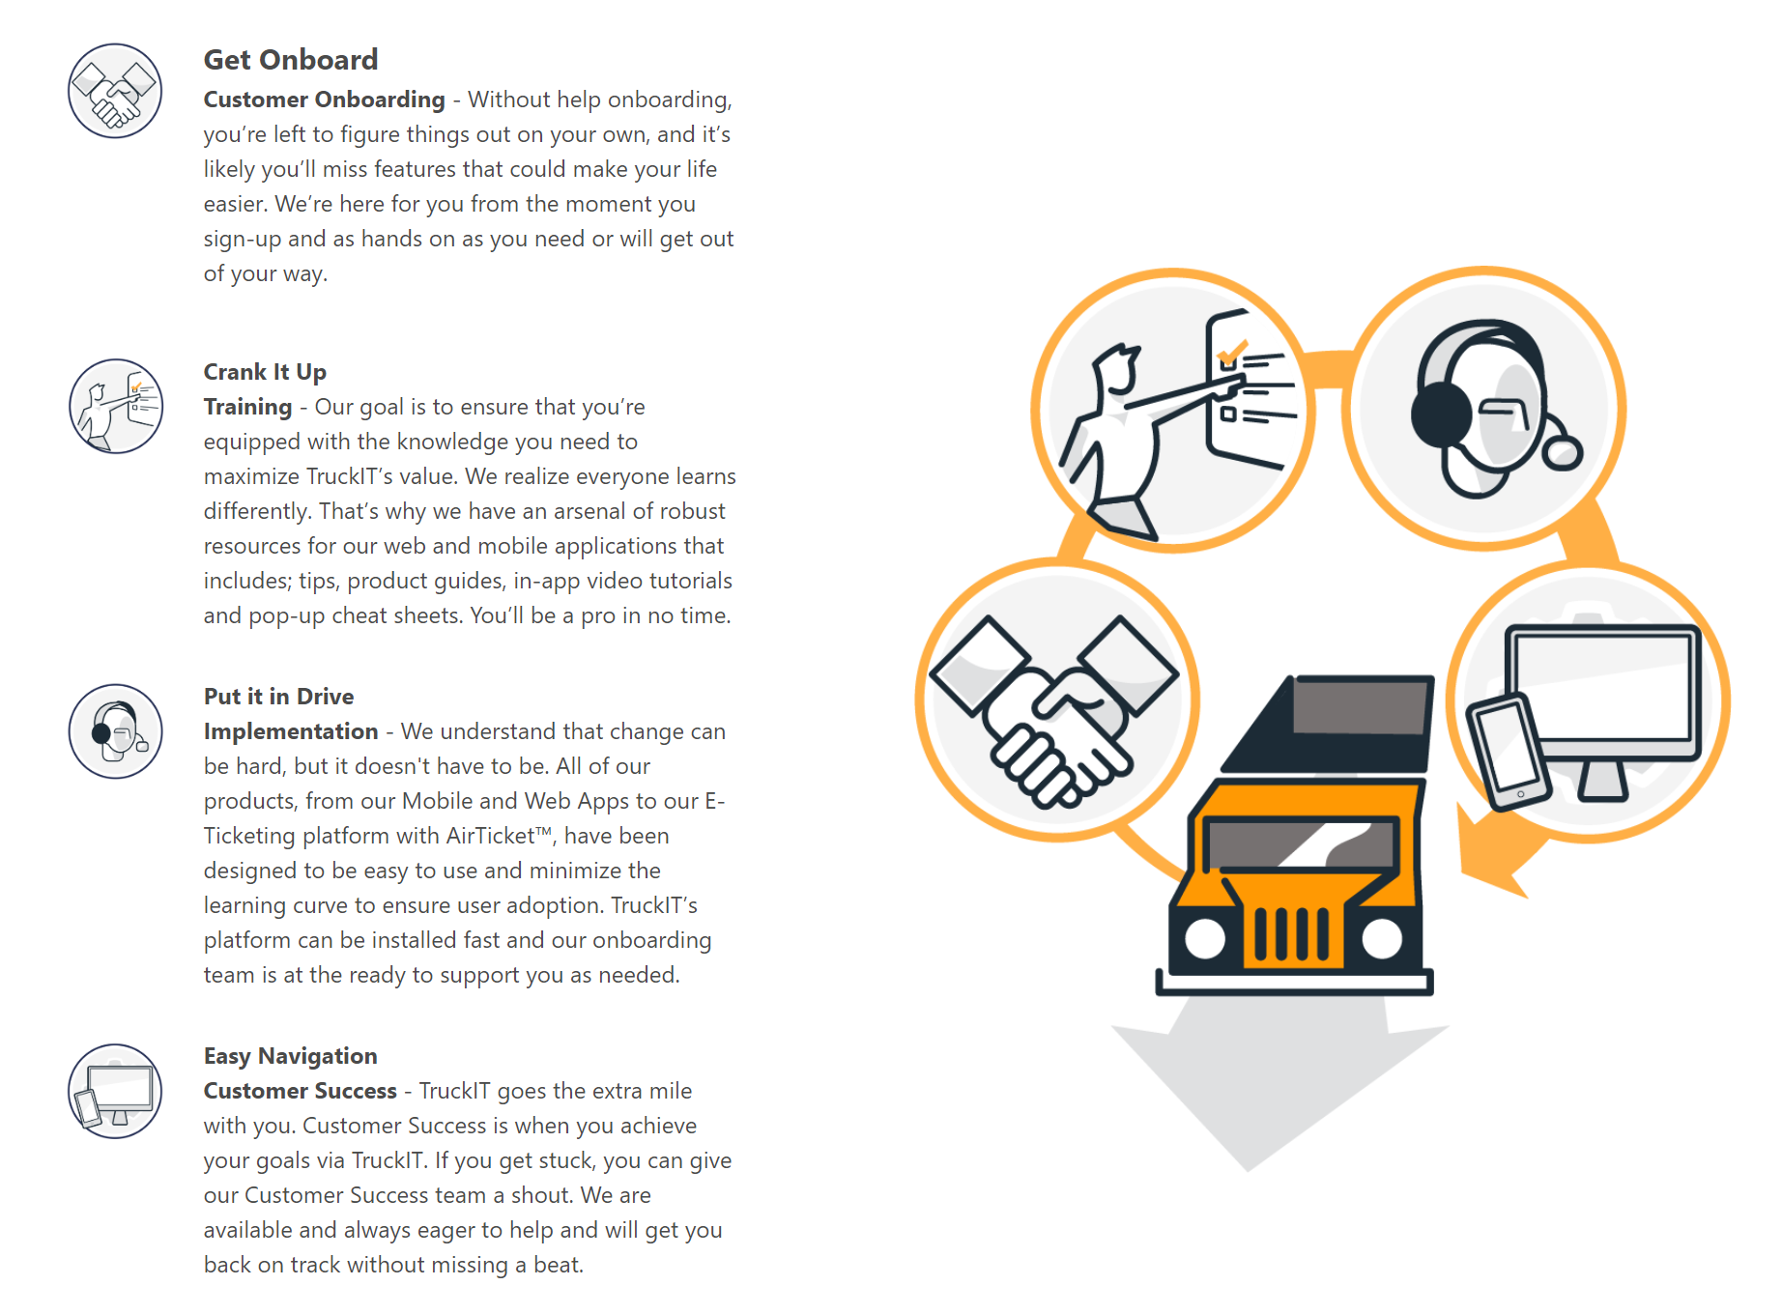
ONBOARDING
Introduction
CUSTOMER SUCCESS
(404) 990-4233
SUPPORT@TRUCKIT.COM

