Slide 1
Taking Custom Note Sections from Good to Great

Slide 2
Note Examples

Slide 3
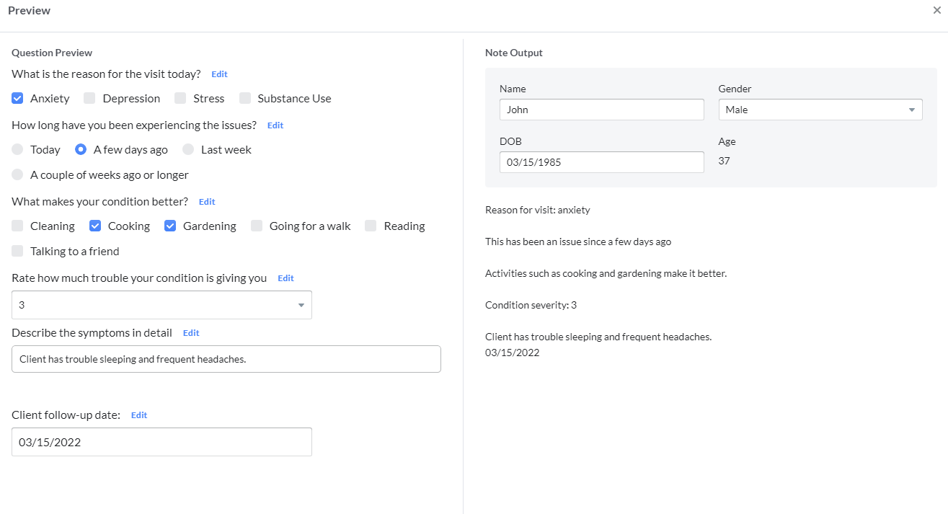

Slide 4
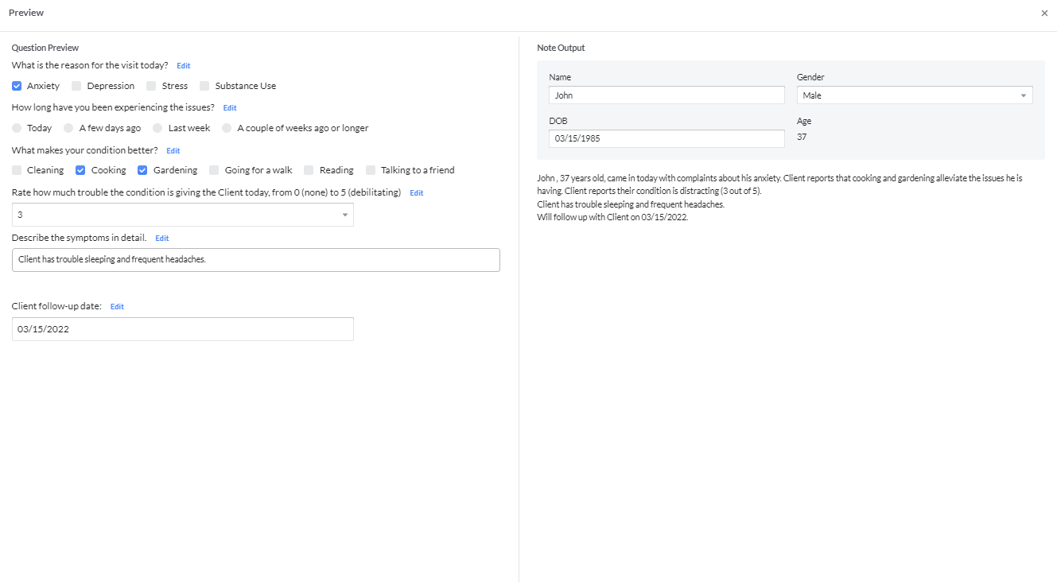

Slide 5
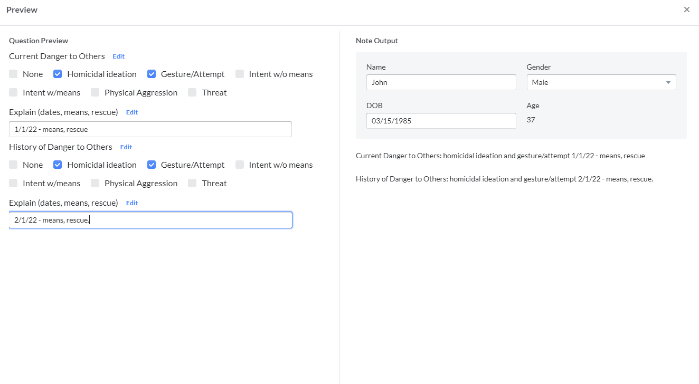

Slide 6
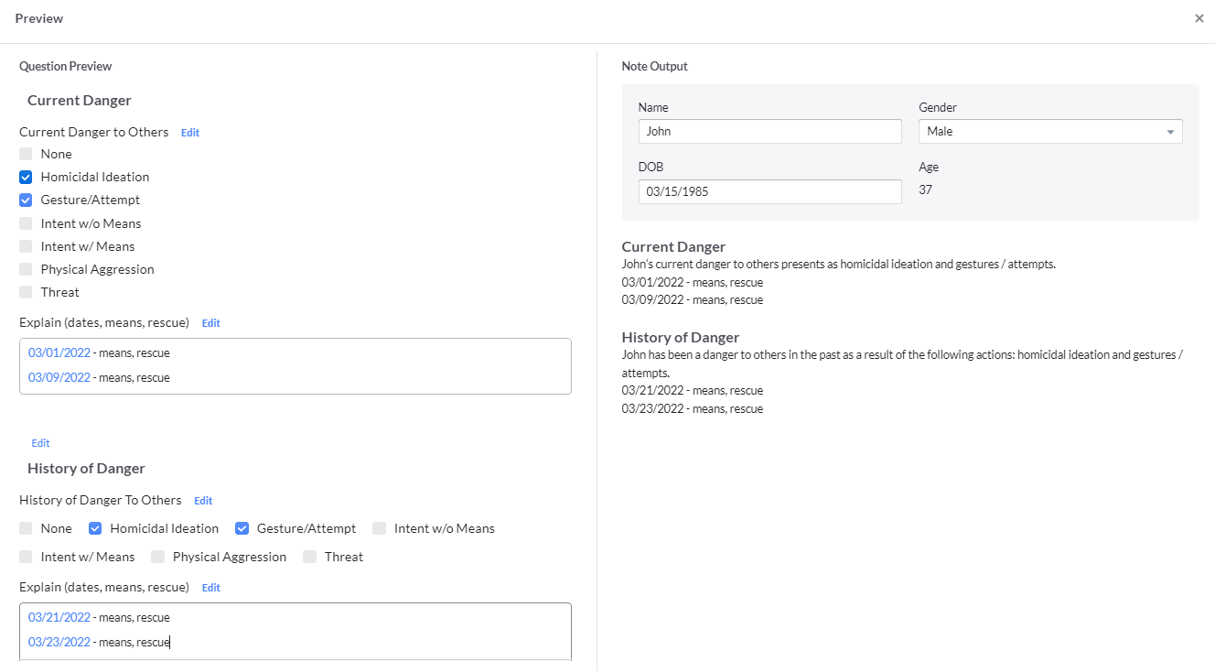

Slide 7
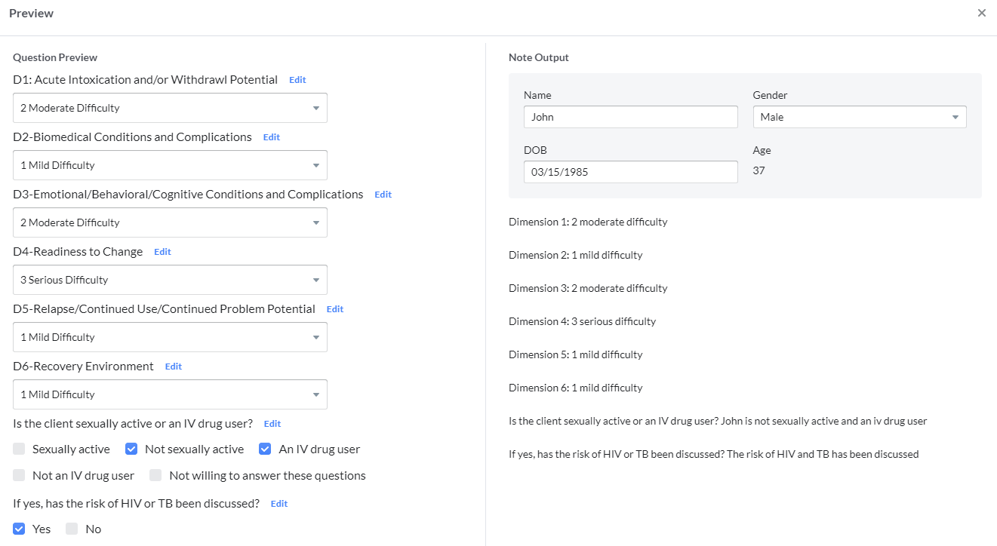

Slide 8
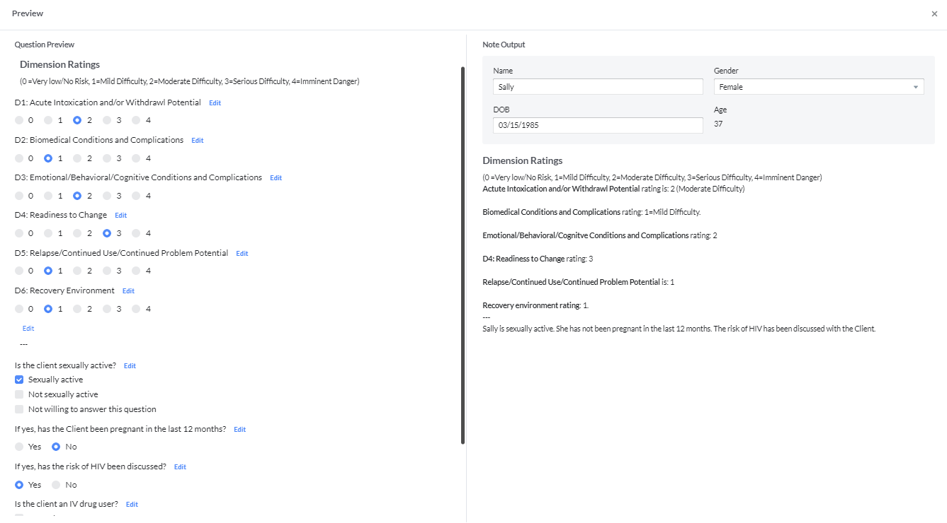

Slide 9
Custom Note Sections Best Practices
Placeholders (add them by typing $ and selecting from the list) are your friend.
Strive for narrative output.
Remember the punctuation at the end of the output.
If you don’t have paragraph breaks, one question’s output will lead to the next question’s output.
Use Demographic settings on the right of each question to make the CNS more patient-aware.
Lists – consider the Layout setting of vertical vs. horizontal. The tradeoff is scrolling up and down vs. readability.
Checkboxes - avoid conflicting selection options, such as ‘overweight’ and ‘underweight’.
Typically Custom Note Sections are only one part of a larger note type, so the bigger the section, the larger the over-all note.

Slide 10
Thank you!

