Slide 1
Test Run
Insert event name

Slide 2
Agenda
How does it work?
Tips
Schedule for the day
Q&A
Testing phase

Slide 3
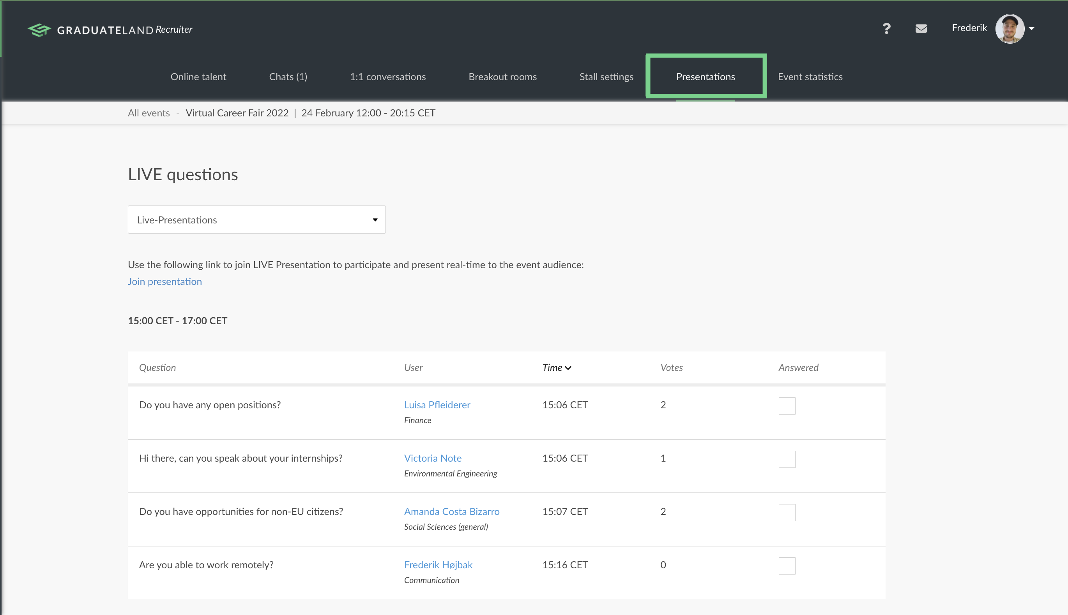
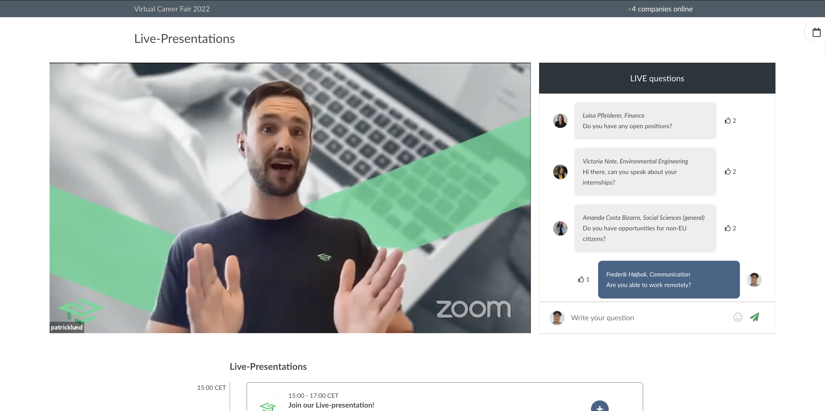
How does it work?
‘Join presentation’ 10 minutes before and make sure to name yourself with “name (company)”
Deliver your presentation in Zoom
Keep an eye on live questions from attendees in the event platform and answer them out loud

Slide 4
Tips:
Secure a stable internet connection
Keep yourself muted and hidden when not presenting
Have a neutral background and use a headset with microphone
Have two windows open: Zoom & the event platform
Stick to the allotted time
We do not recommend you to screen-share videos
Recommend the users to visit your stall at the end of your presentation

Slide 5
Schedule
Schedule for the day
Insert date of the event
10.00-10.20: Company 1
10.20-10.40: Company 2
10.40-11.00: Company 3
11.00-11.30: BREAK
11.30-11.50: Company 4
11.50-12.10: Company 5

Slide 6
Questions?

Slide 7
Testing phase
Camera
Microphone
Screen sharing

